Slide 1
An Investigation of Opportunities and Barriers to Biogas Systems in Rural Communities
Huy Cao, Jordan Rosenfeld,
Jill Schilp, Noah Shoer
Notes:
Jill

Slide 2
Problems in Rural Communities
Fossil Fuels
Greenhouse gas emissions
Expensive
Waste
Greenhouse gas emissions
Pollution
Health
Respiratory
Pollution
Mental
Notes:
Huy
We want to start by talking about the problems that the current rural communities have. First, rural communities are overdependent on fossil fuels. This leads to the emission of greenhouse gas, which is bad for the environment. Also, fossil fuels are expensive source of energy. Second, there’s waste management issue in rural areas, partly due to the leakage of waste from fossil fuels to the soil. This will also lead to greenhouse gas emission in the form of methane. Additionally, the waste would create pollution. Third, there’s a health consequences due to the use of fossil fuels and the waste management issue. Specifically, there’s respiratory illness due to the smoke from burning firewood and charcoal. In fact, it is one of the main cause of death in rural Africa. Additionally, pollution caused by waste management issues also lead to health issues such as respiratory or skin related diseases. Finally, the use of fossil fuel create a burden on the financial income, which will lead to stresses and mental illness.

Slide 3
Biogas: A Potential Solution
Notes:
Jill – Based on our research done on the benefits of biogas we have determined that biogas could be a potential solution to the previously stated problems with rural communitites

Slide 4
Reduced Fossil Fuels
Lower emissions
Inexpensive
Waste Elimination
Lower emissions
Lower pollution
Health Improvement
Less waste
Safe fuels
Benefits
4
Notes:
Huy
First of all, biogas can be used as the alternative energy source to fossil fuel. This would lead to lower greenhouse gas emission and provide rural communities with an inexpensive source of energy. Second, biogas can help with waste elimination by using the waste as the input feedstock. This would lead to lower emission of greenhouse gas in the form of methane, and effectively reduce pollution. Finally, biogas can improve the health problem that occur with fossil fuel, as it is a safe and clean source of fuel and it disposes less waste to the environment compared to fossil fuels.

Slide 5
Biogas Implementation in Rural Communities
Kibbutz Lotan
Notes:
Noah – Jill
Rural communities around the world have attempted to implement biogas systems for the benefits listed before, notably in China, Africa, and on Kibbutz Lotan where our project took place.

Slide 6
Biogas Loop Cycle
Notes:
Noah – Jordan
The main reason for implementation to reap the benefits of biogas systems is the biogas loop cycle, which makes it an inexpensive, renewable source of energy
Biogas creates the benefits described by Huy through the Biogas Loop Cycle.

Slide 7
Feedstock
Anaerobic Digestion
Biogas & Digestate
Electricity & Gas, Fertilizer
Food Production
Notes:
Noah –Jordan
The biogas loop cycle converts organic feedstocks into biogas. Feedstocks are any organic material including food waste, animal waste, human waste and other sources of biomass. These feedstocks are broken down into biogas through anaerobic bacteria, or the breakdown by bacteria in the absence of oxygen at specific temperatures. The two products of this process are biogas and the digestate byproduct. Biogas can be converted into electricity and gas, and digestate can be used as a fertilizer. Both these things then contribute to food production, which produces the feedstock used at the beginning. The Biogas Loop Cycle is the process by which a feedstock is turned into gas. Feedstocks are any organic material, be it food waste, animal waste, human waste or other biomass. These feedstocks are broken down through anaerobic digestion, or the breakdown by bacteria in the absence of oxygen at specific temperatures, and turned into biogas and digestate. The biogas can be used as electricity and gas, and the digestate as a fertilizer. All three of these things are used in food production which produces the feedstock used at the beginning of the cycle.

Slide 8
We evaluated the potential performance of biogas systems in rural communities
Notes:
Jill

Slide 9
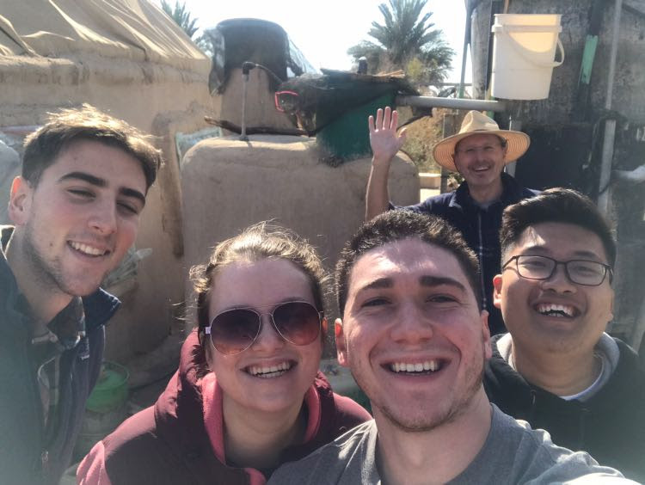
Kibbutz Lotan
Notes:
Jill – We complete this project on Kibbutz Lotan in the winter months.
This is warmer winter climate then most.

Slide 10
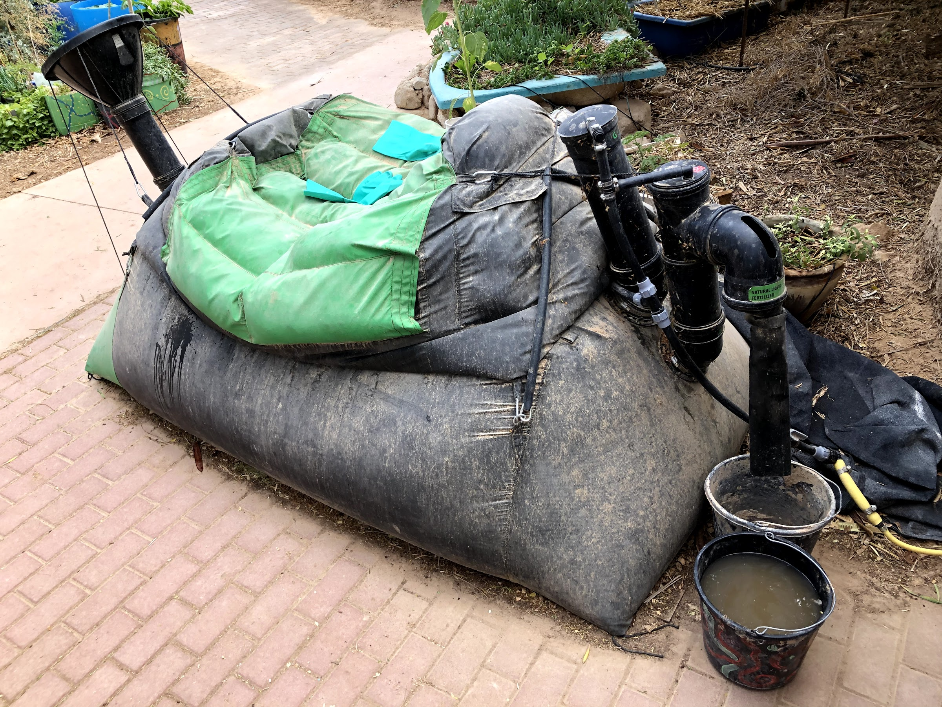
HomeBiogas® 2.0 System
Notes:
Jordan
This is the specific homebiogas 2.0 system we conducted our experiments on

Slide 11
Biogas System Evaluation
Gas Production
Digestate Use
System Usage
Notes:
Jordan
We observed and conducted interviews with current and past users of biogas systems to evaluate the gas production, digestate use, and overall system usage.

Slide 12
Burn Time
Maintenance
Resources
Awareness
Notes:
Jordan
Our project was mainly impacted due to working in the winter. We found that the burn time was greatly effected and resulted in a much lower duration than previously claimed
The lack of implementation was due to the lack of resources in owners as well as the high level of maintenance required
Along with the dis-adoption, the social awareness and overall knowledge about biogas technology

Slide 13
Insufficient Gas Production
Burn Time
Notes:
Noah – Jill
During our testing of the system’s gas production, we initially found disappointing results in the burn time. However, this is not that unexpected as it is winter time, and anaerobic bacteria require temperatures of around 30C to produce biogas. To attempt to achieve this, we began using the water in the in the digester and covered the system in a green plastic bag to simulate a greenhouse. After we did this the production increased by around 4.5 times, as you can see after February 1st on the graph.

Slide 14
“The flame is not hot enough to use and the burn time is not long enough to cook with”
Burn Time
Notes:
Noah –Huy
In our own experience and based on interview results, the produced flame in the winter is not hot enough or lasts long enough to cook with. We were unable to cook popcorn kernels with our system, but that is most likely due to the system being placed outside.

Slide 15
2h 00m
0h 11m
0h 48m
HomeBiogas® Claimed Burn Time
Unheated Digester Burn Time
Burn Time
Heated Digester Burn Time
Notes:
Noah – Huy
We can see that even when we increased the average daily burn time from 11 minutes to 48 minutes, the systems production still fell far below the claimed burn time of 2 hours. This indicates the gas production needs to be significantly increased to make biogas systems usable.

Slide 16
“I have so much excess gas in the summer I could benefit from an extra gas tank”
Burn Time
Notes:
Noah – Jordan
However, our testing did take place in the winter time. An interviewee who uses the HomeBiogas system through the year said that in the summer he easily hits the 2h burn time, and actually suggested an additional gas tank to handle all the gas produced in the summer.

Slide 17
Improving the Gas Production
Heated Slurry
Greenhouse
Increased Production
Burn Time
Notes:
Noah –Jordan
In order to improve the gas production in the future, we recommend heating the input slurry water using a solar water heater, as heating it another way would negate the renewable energy benefit. Furthermore, we suggest constructing a full scale greenhouse around the digester to maintain the temperatures for digestion. We recommend making it out of plastic as it is affordable and maintains heat very well. Our hope ois that both these recommendations will increase production to a level usable throughout the year.

Slide 18
Accessible Fertilizer
Resources
Notes:
Jill
We found that an abundance of biogas digestate is produced daily, and it could be used as a fertilizer but we can not claim that biogas is a better fertilizer than store bought
We were unable to test quantitatively due to miscommunication and killing all the pants and not enough plants germinated to be able to have adequate qualitative data
Testing qualitatively and testing between plants that have received 100% and 50% Biogas fertilizer to plants that only received water
Based on quantitative data the plants that received the biogas digestate were found to be on average .1cm taller and have .01 more leaves then the plants that only received water
- Visually the plants that received the biogas digestate looked better

Slide 19
Suggested Uses
Fertilizer
Cooking
Heating
Lighting
Resources
Notes:
Jill – suggested uses of the biogas outputs of both the digestate and the biogas
- with the biogas we recommend that it is used for cooking and heating and lighting in rural communities in very specific settings, such as in warm climates
- We suggest that the biogas digestate is used for a free and accessible fertilizer.

Slide 20
“When we feed the system, it often gets jammed and you have to work really hard to unjam it.”
Maintenance
Notes:
Jordan

Slide 21
“The really, really bad smell”
Maintenance
Notes:
Jordan

Slide 22
Auger Feeding System
CRANK
INPUT COVER
OUTPUT
INPUT
Maintenance
Notes:
Jordan

Slide 23
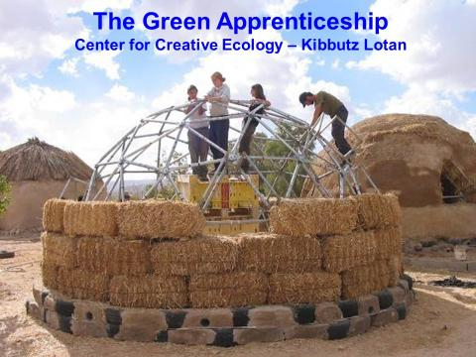
Biogas Education Program
Awareness
Notes:
Huy

Slide 24
Educational Software
Awareness
Notes:
Huy
To raise the people awareness about biogas, educational programs and materials are needed. We proposed two different models as a material for biogas education. First of all, an educational software in the form of a game would help conveying the information about biogas. The game will start with an animation explaining how biogas is produced. Then, the user can play around with the condition parameters, such as the ambient temperature, the combination and the amount of feedstock, to achieve the best gas production. The gas production will be represented in the form of the gas burning time on a stove. The biogas digestate quality will be represented as the growth of the

Slide 25
Biogas Student Educational Kit
BALLOON GAS TANK
Place your screenshot here
DIGESTER TANK
BUNSON BURNER
Awareness
DIGESTATE OUTPUT
Notes:
Huy

Slide 26
Future Testing Suggestions
Greenhouse
NPK
Auger
Notes:
Jill
Testing a greenhouse setting for the biogas system to improve the burn time
Testing the NPK, which is the Nitrogen, phosphorus, and potassium
Testing the Auger system

Slide 27
Acknowledgements
Alex Cicelsky
Mike Kaplin
Seth Tuler
Isa Bar-On
Anna Correia
Karistan Swan
Quang Huynh
Roni Mandel

Slide 28
Thank You!
Notes:
Someone

