Slide 1
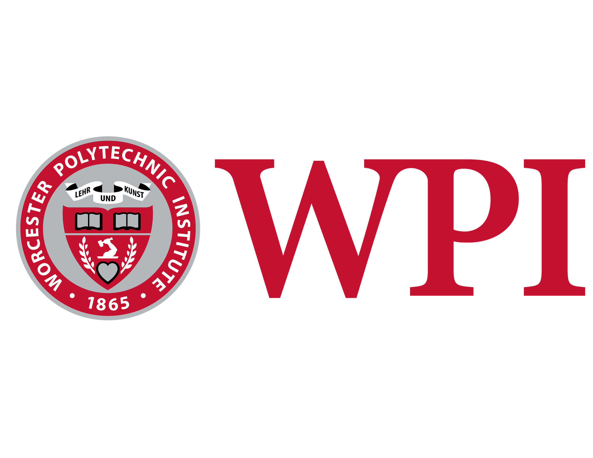
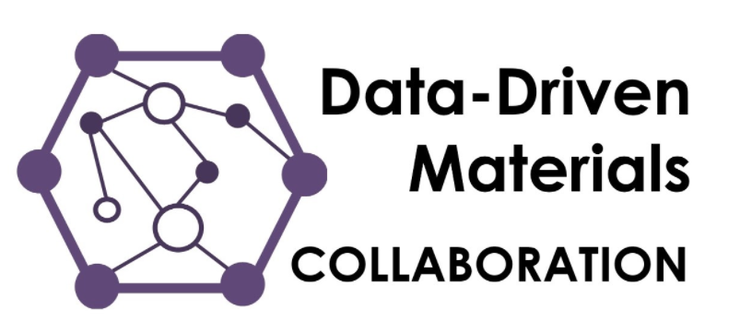
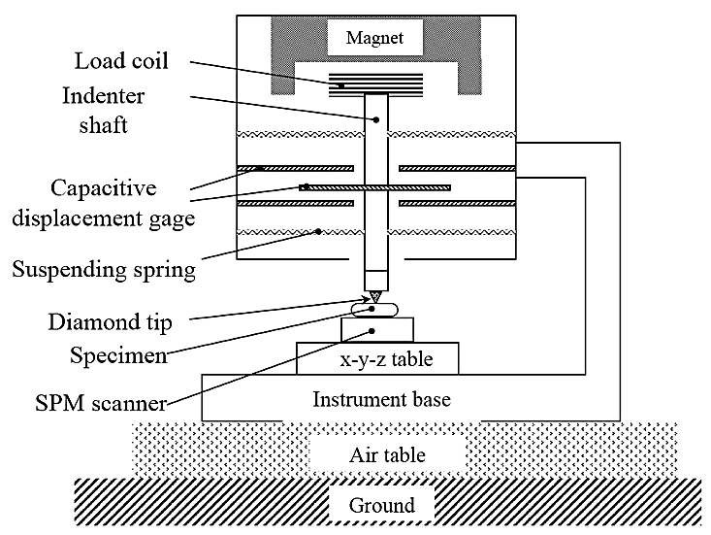
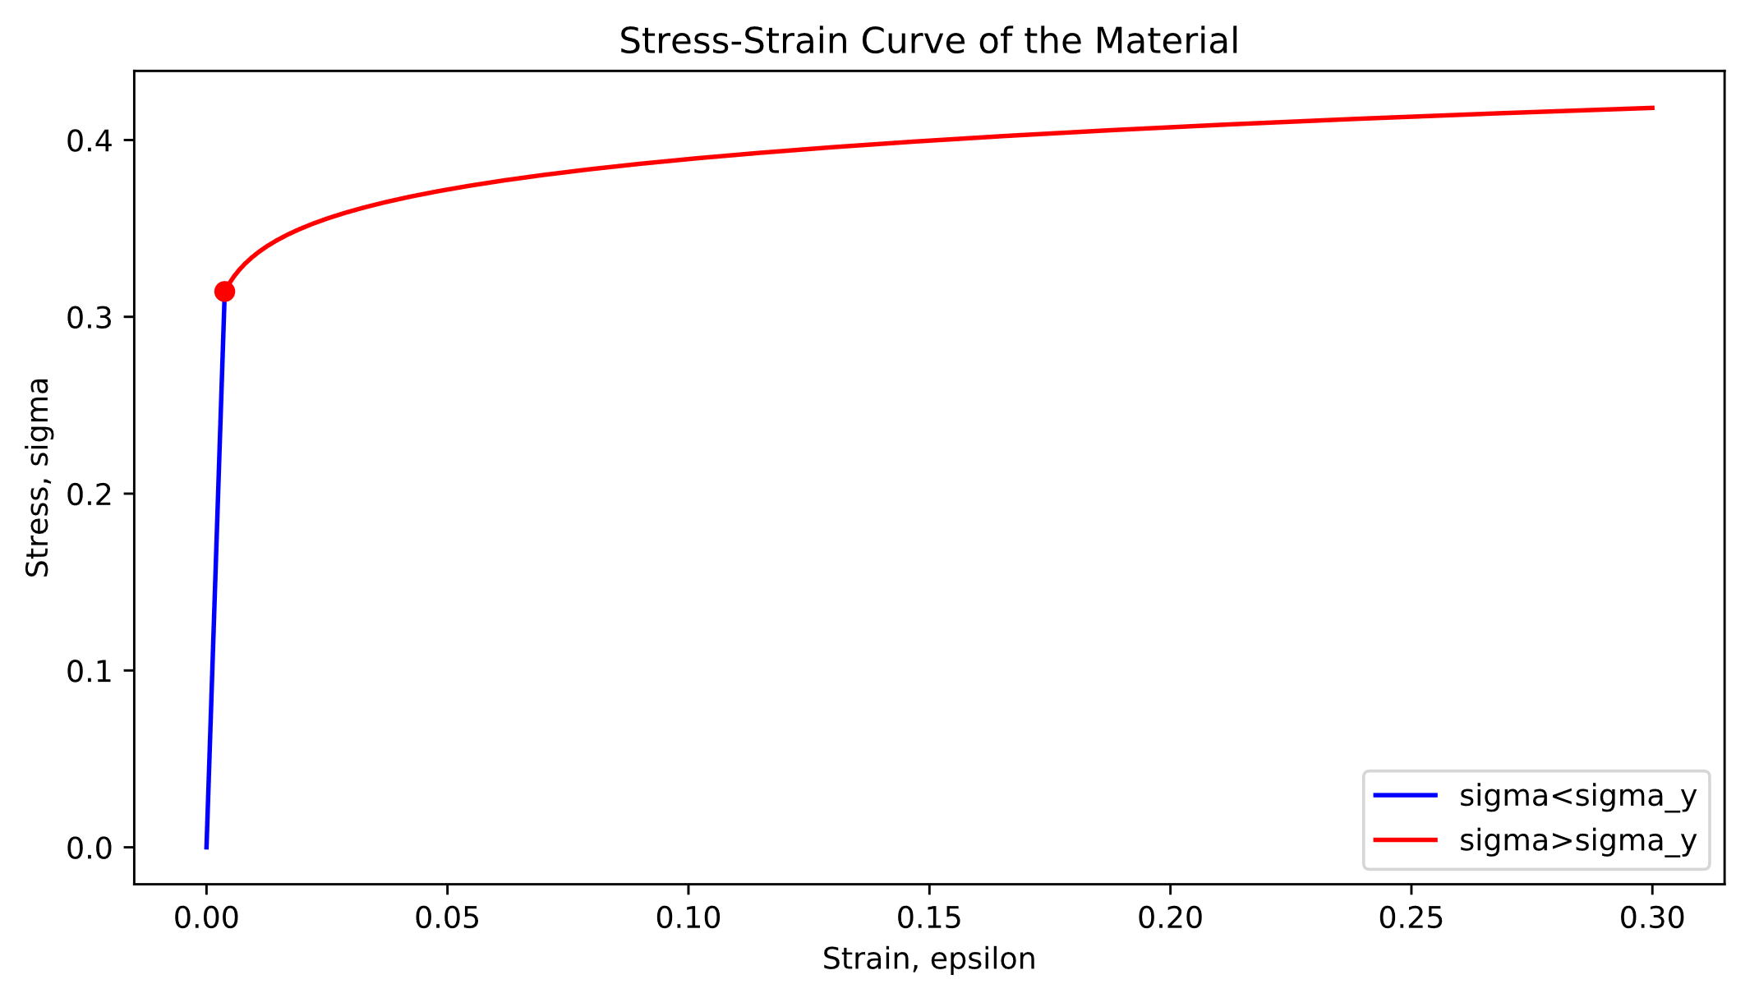
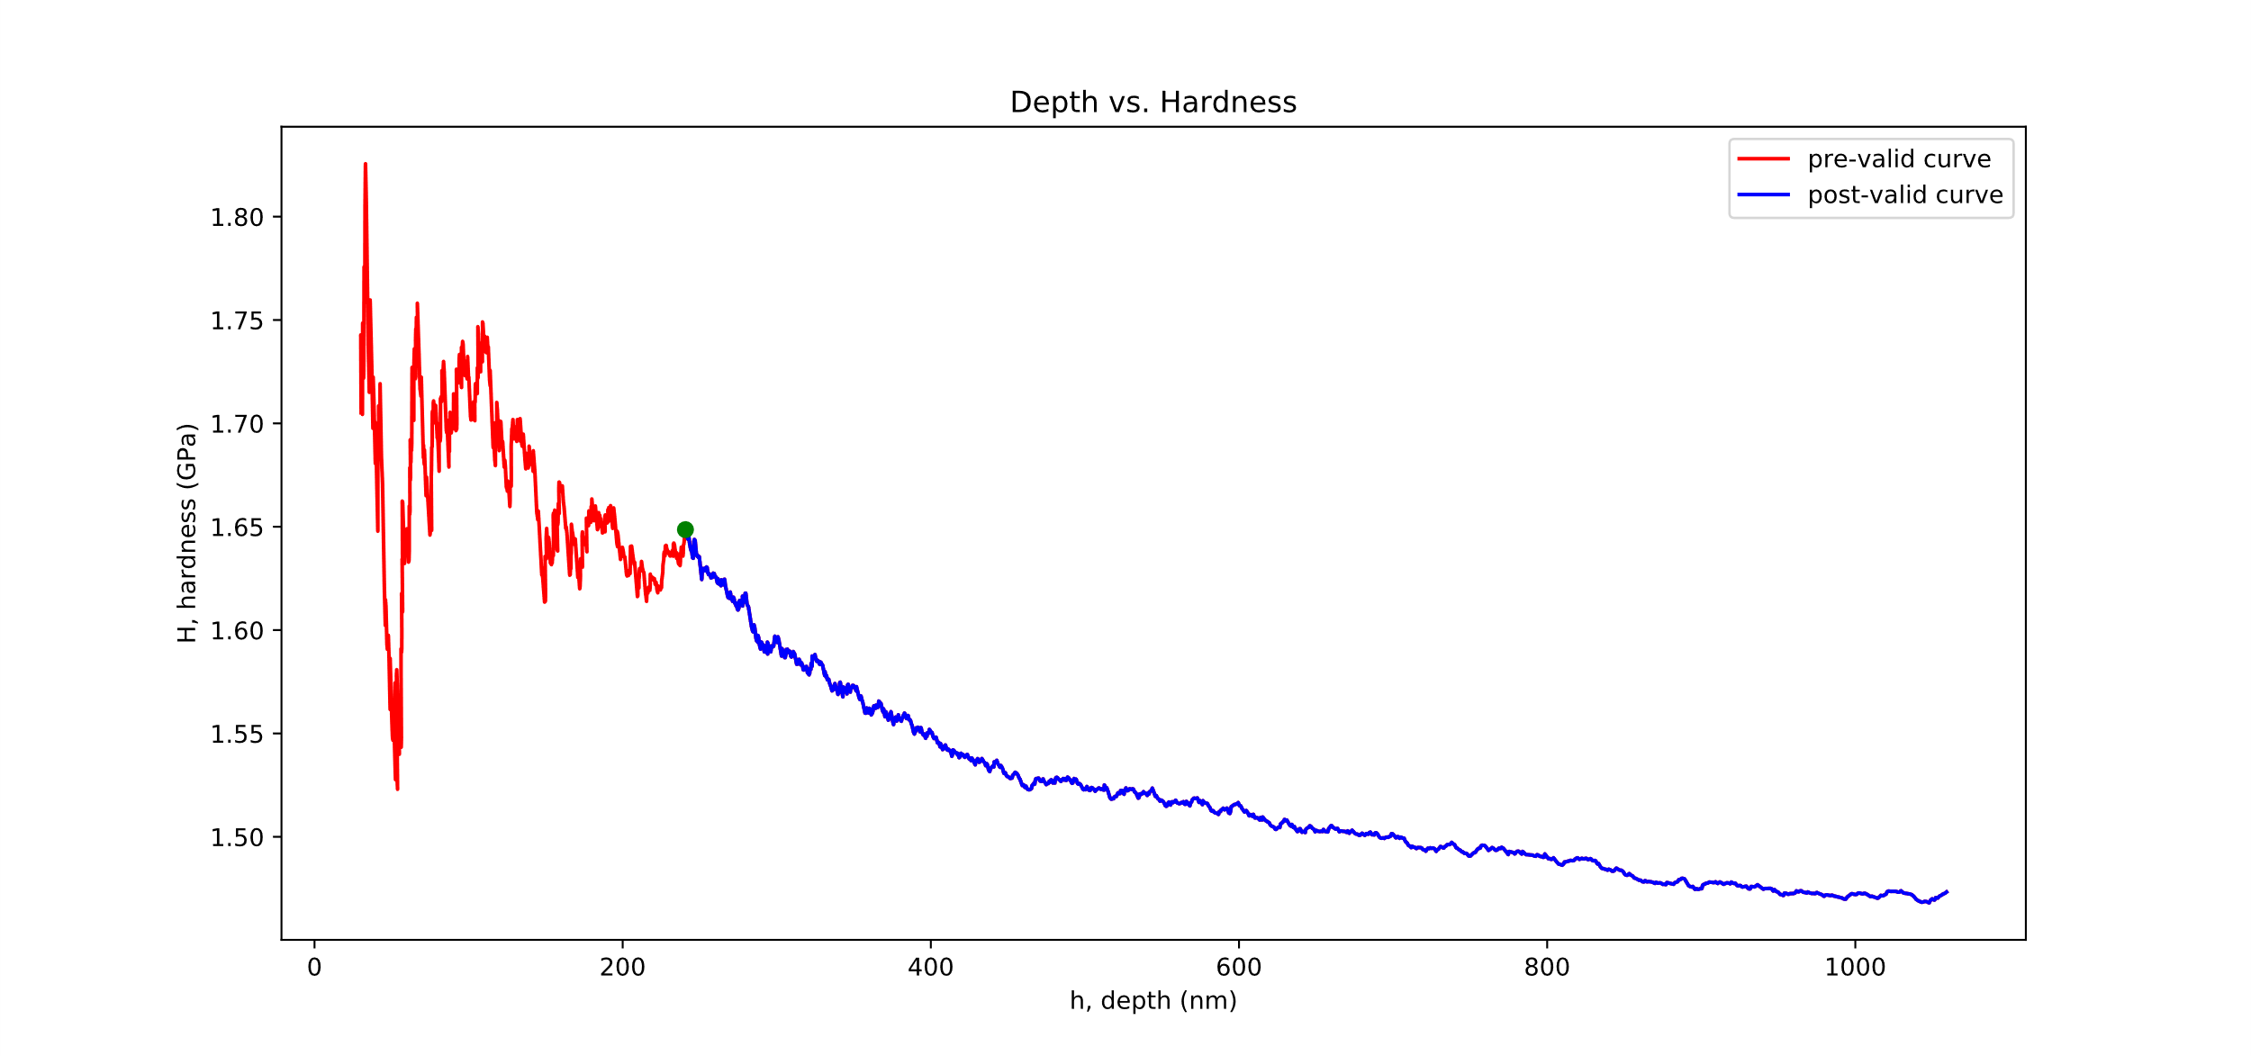
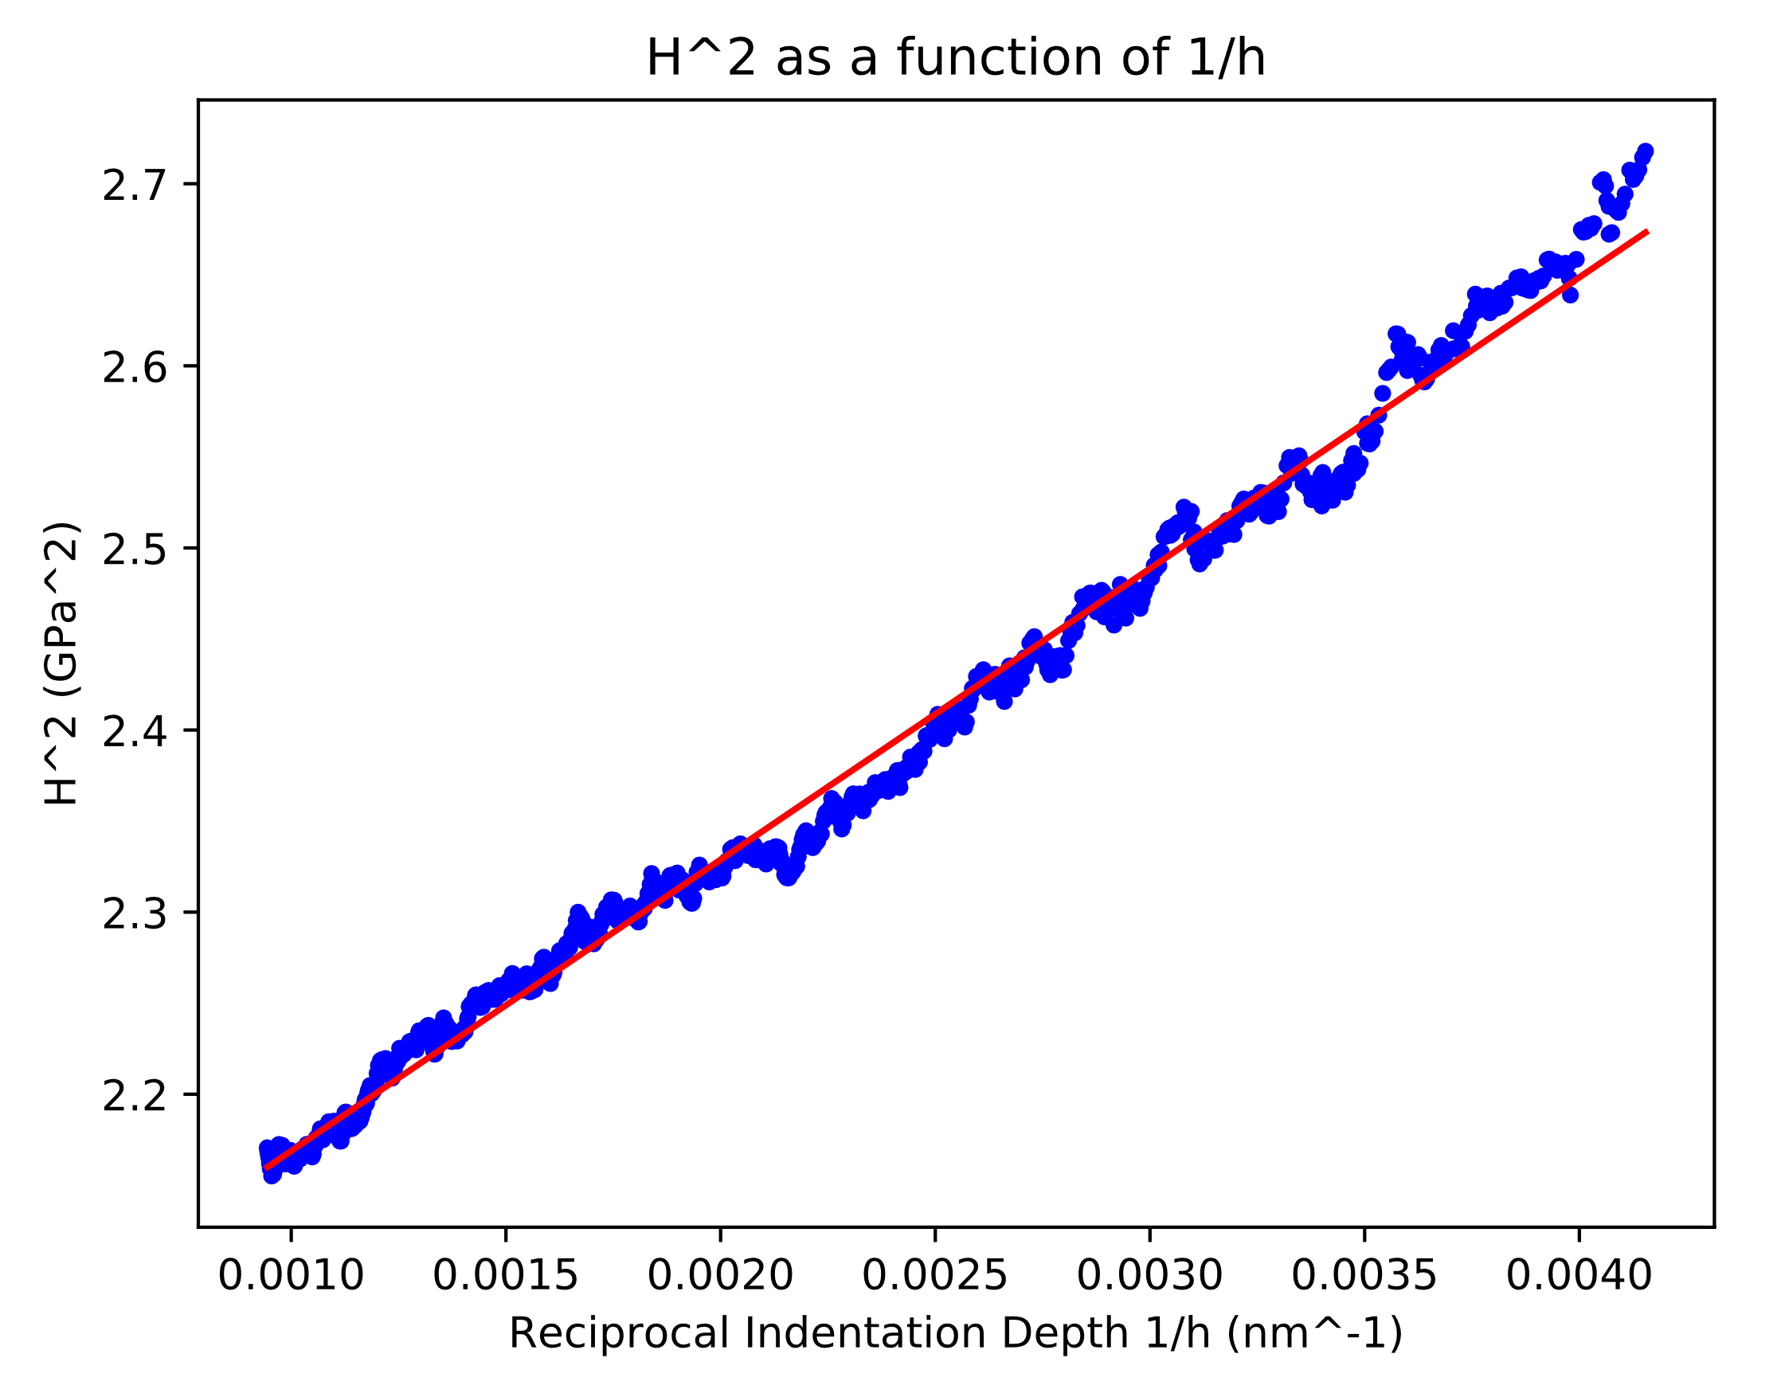
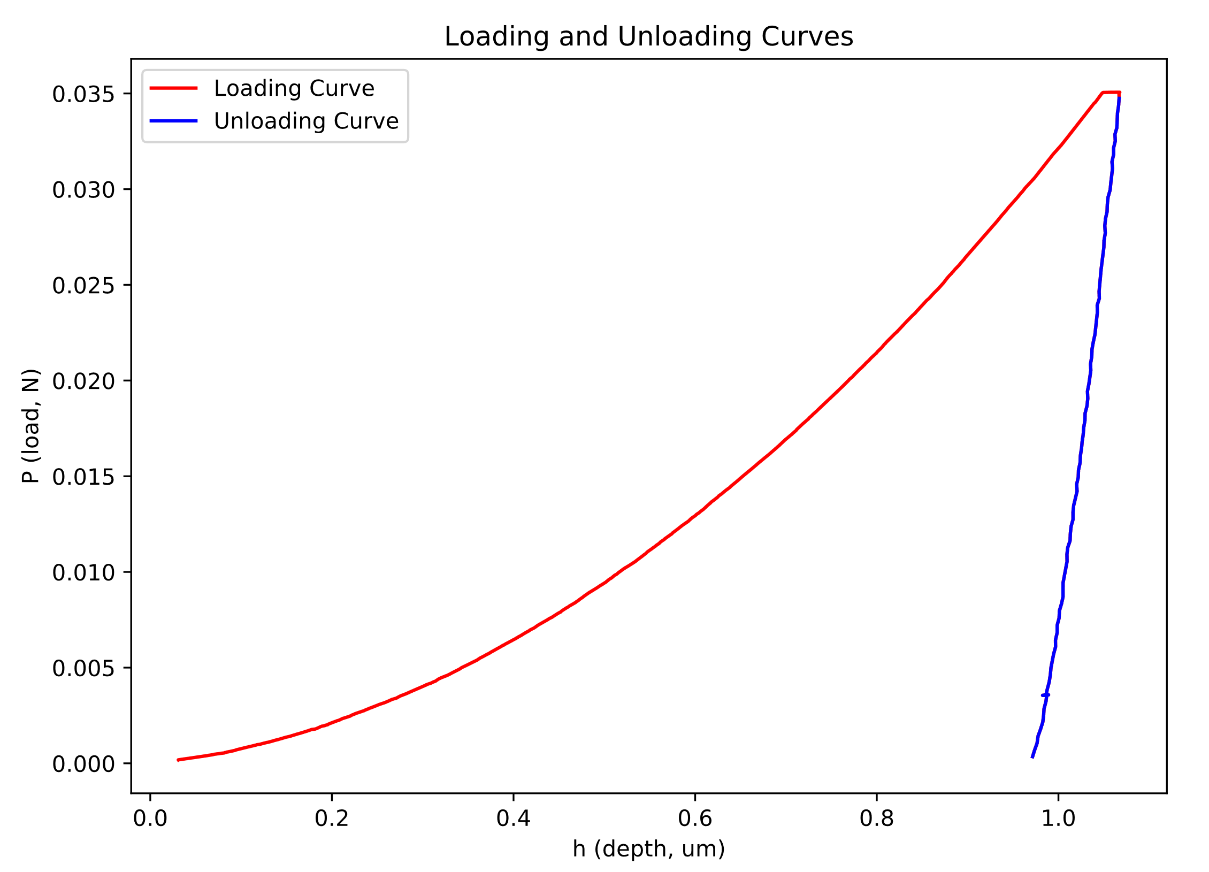
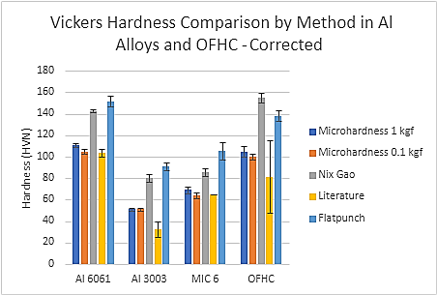
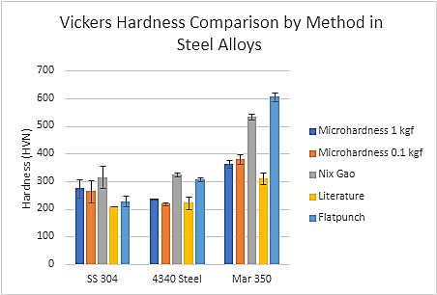
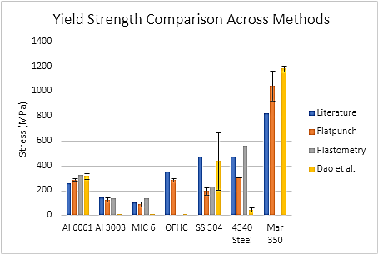
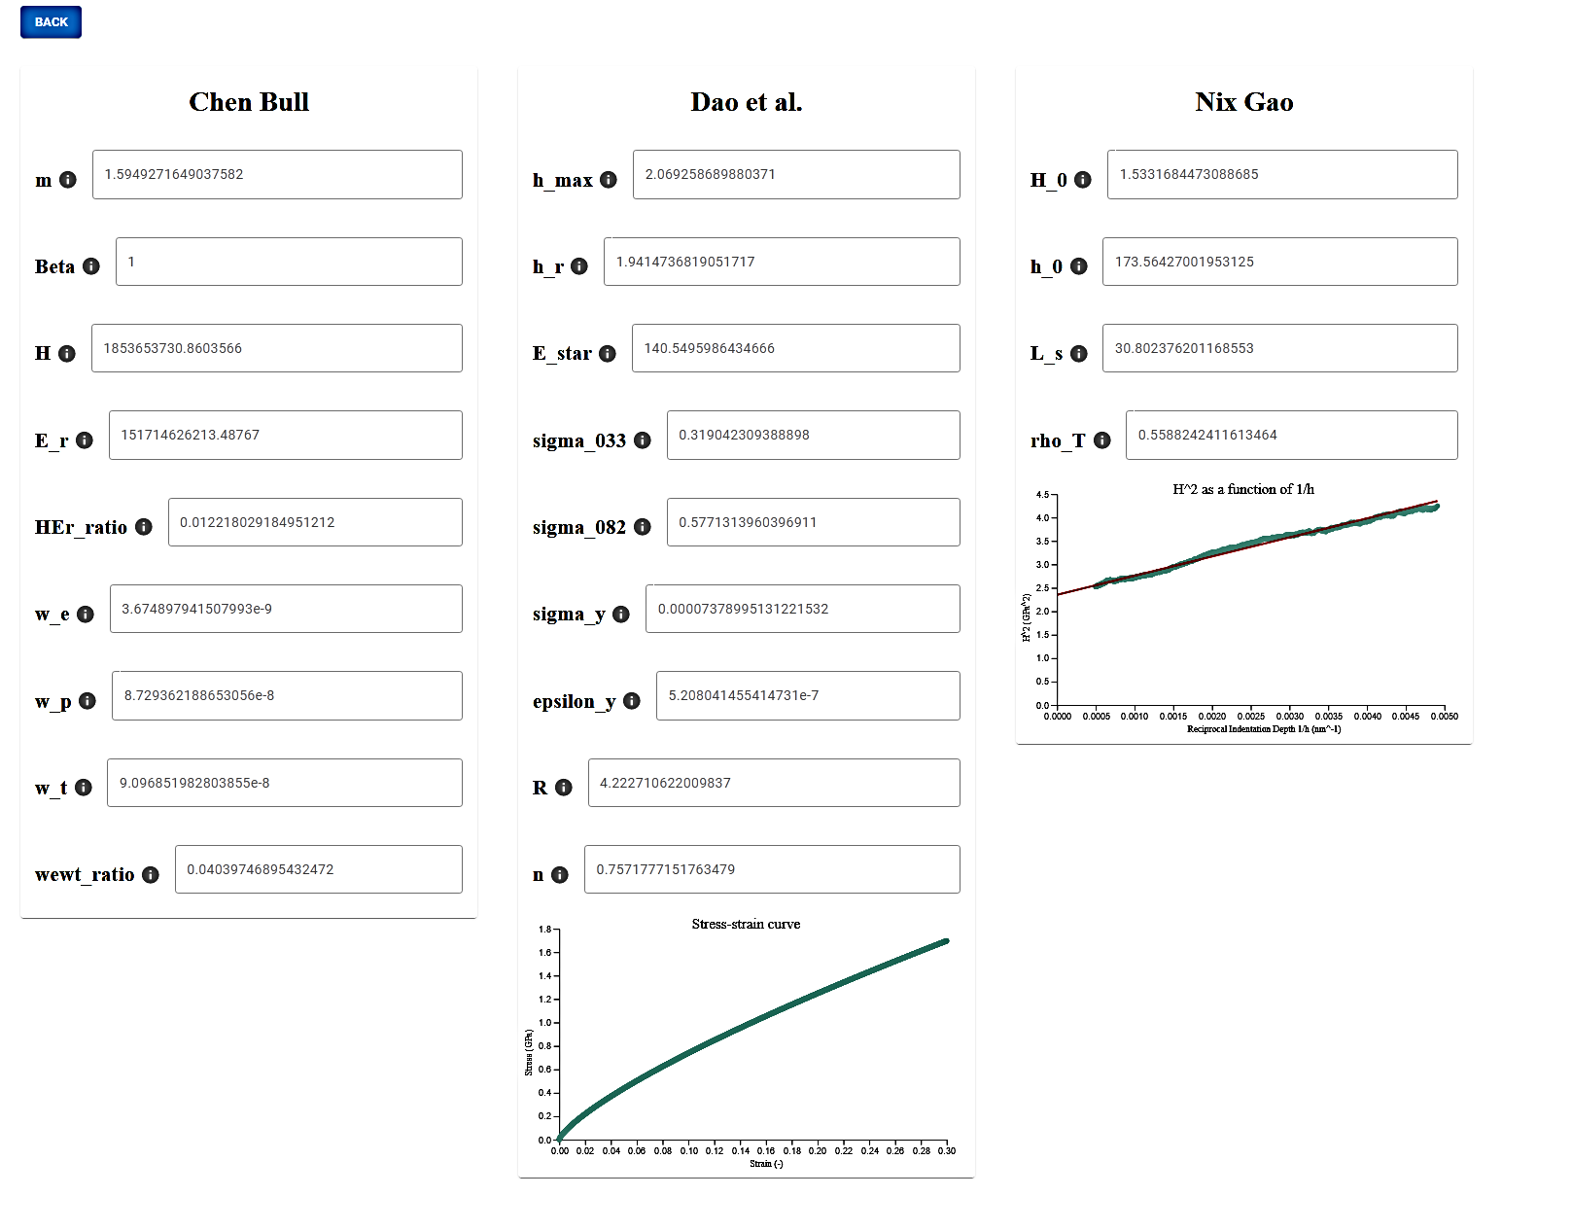
UNiT: A Universal Toolkit for Nanoindentation Exploration
Authors: Katelyn Barron (ME), Aaron Krueger (CS), Eric Schmid (CS)
Advisors: Prof. Danielle Cote (MTE), Prof. Rodica Neamtu (CS)
f
Challenges
Motivation
Algorithms
Nanoindentation is a materials science process that measures several features of a material
This method generates large amounts of data
While data evaluation methods exist, many are complex and therefore inaccessible.
Dao et al.: Stress Strain Evaluation
Calculates the stress-strain curve of a given material, as well as other features
Uses complex formulas that are not easily calculated by hand
Unusable Data
Before a certain depth, data is too sporadic to use
This can vary across algorithms
Nix-Gao: Hardness in the Limit of Infinite Depth
Used to determine hardness in the limit of infinite depth, or Vickers hardness
By plotting $H^{2}$ as a function of $\frac{1}{h}$, we can use linear regression to find $H_{0}^{2}$ on the y-intercept
Algorithm Difficulties
Dao et al. did not output expected values for some materials
Goal
Material Selection
Provide a user-friendly tool for accurately analyzing large nanoindentation datasets to allow for rapid materials characterization and discovery
A diverse selection of metals were chosen to test the range of UNiT’s capabilities
Chen Bull: Work of Indentation and Hardness and Reduced Modulus
Calculates the ratio of Hardness to Young’s Modulus for a conical tip
Found some potential issues in the paper’s methods of calculation
Materials
1. Aluminums: Al 6061, Al 3003, MIC 6
2. Steels: 304 Stainless Steel, 4340 Steel, Mar 350
3. Copper: OFHC
Nanoindentation Data Set
Nanoindentation data has many features, but some are more important than others
Each experiment consists of several tests, which each have >1000 rows of data
Data before a certain point is unusable
Validation & Results
Comparing Yield Strength and Hardness to Traditional Methods
Indentation Plastometry, Nanoindentation, Microhardness Testing, Literature
Future Steps
Improve Evaluation on Multiple Tests
Running algorithms on multiple tests may help reduce errors from intramaterial variation
Remove outliers from material surface deformities or other sources of nanoindentation data outliers
User Interface Design
Add New Algorithms
Add new algorithms to compute other material properties or try alternative algorithms to compute the same properties already computed by UNiT
Built using Typescript, React.js, and the Material UI toolkit
Accuracy
Results were in the correct order of magnitude and generally within the error of other methods
Unexpected Results
Dao et al. gave extremely low results for many materials, possible due to intramaterial variation
Conclusion
Nix Gao and Dao et al. provide useful results, but some work is needed for Dao et al. to work more universally for materials
Interface tiles dynamically to accommodate inputs and results from a varying number of algorithms
Displays both numerical and graphical results
Acknowledgements
We would like to thank professors Danielle Cote and Rodica Neamtu for advising and assisting with this project.
We would also like to thank Bryer Sousa for sharing his vast materials science expertise and support on this project.
Lastly, we would like to thank the materials scientists who participated in user testing.
User Testing
Gathered feedback on user interface and experience from materials scientists

