Slide 1
Movies chapter 2

Slide 2

Movie S1

Slide 3

Movie S2

Slide 4

Movie S3

Slide 5

Movie S4

Slide 6

Movie S5

Slide 7

Movie S6

Slide 8
Movies chapter 3

Slide 9
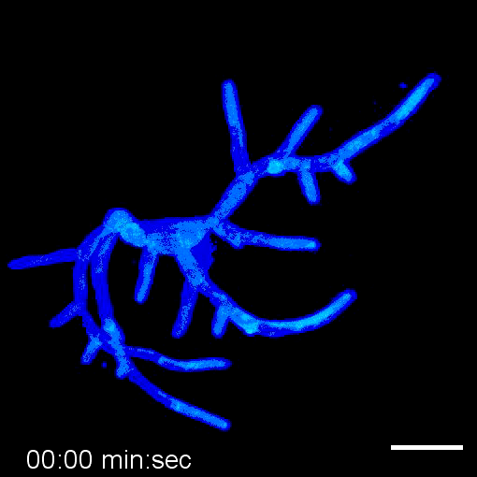
Movie S1

Slide 10
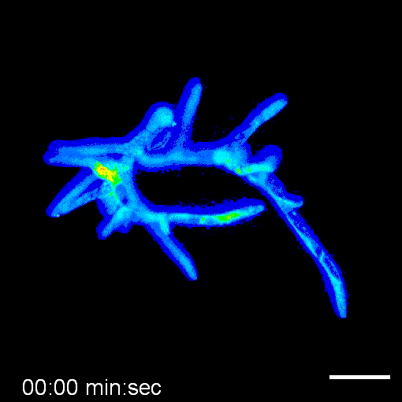
Movie S2

Slide 11
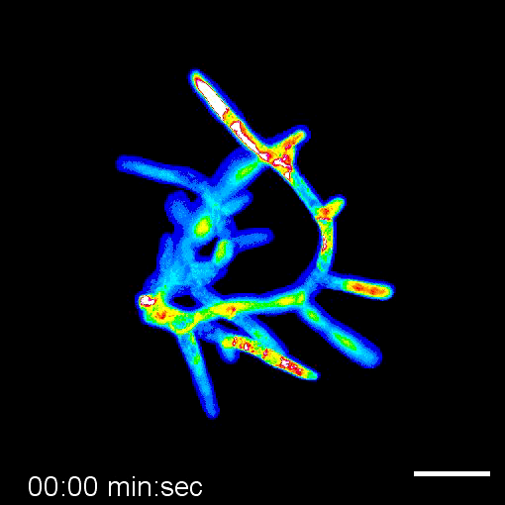
Movie S3

Slide 12
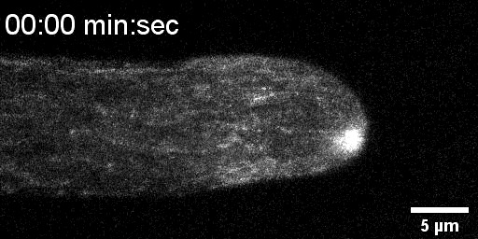
Movie S4

Slide 13
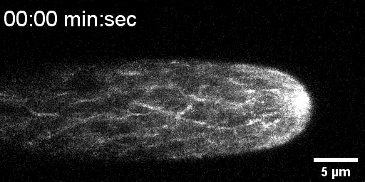
Movie S5

