Slide 1
Bienvenue!
Welcome!

Slide 2
Établir un Processus pour la Conception d'un Espace Inclusif
Establishing a Process for the
Design of an Inclusive Space
Isabelle Ho, Olivia Petropulos, Ezra Vail, Mike Viozzi
Notes:
Isabelle
Bonjour, Hello
notre équipe a travaillé avec une organisation, SINGA, pour établir un processus de conception d'un espace inclusif.
our team has been working with a non profit organization named singa to establish a process them to design of an inclusive space.

Slide 3
La Crise des Réfugiés est un problème mondial urgent
The Refugee Crisis is an urgent global issue
Refugees
Definitions:
Asylum Seeker: Someone seeking international protection
Refugee: Someone who has asked for protection and given refugee status
Background
Methodology
Findings
Recommendations
Notes:
Liv
The refugee crisis is a urgent global issue, There were almost 80 million forcibly displaced people around the world at the start of 2020. Around 30 million of those are refugees, or those granted refugee status, while around 3.5 million are asylum seekers, those applying for protection, we will be addressing these groups of refugees and asylum seekers as new arrivals, or french . People are forcibly displaced from their countries of origin for a multitude of different reasons, like food insecurity, war, or persecution. This represents the exit phase in the journey these new arrivals face. From here they move onto the transition phase where they are physically moving to a new country, this phase is plagued by safety concerns as these groups are typically forced into more unsafe routes. The last phase in the journey of a new arrivals is the entry phase into their new country. Those who leave their country of origin rarely chose to do so, yet upon arrival they are not met with open arms. Additionally, the needs of the new comers are not met, this can be represented by the 2.6 million refugees who live in camps that are overcrowded and without proper sanitization. In addition, Issues of prejudice persist globally and serve to increase public anxiety over immigration surrounding issues like crime and job availability.

Slide 4
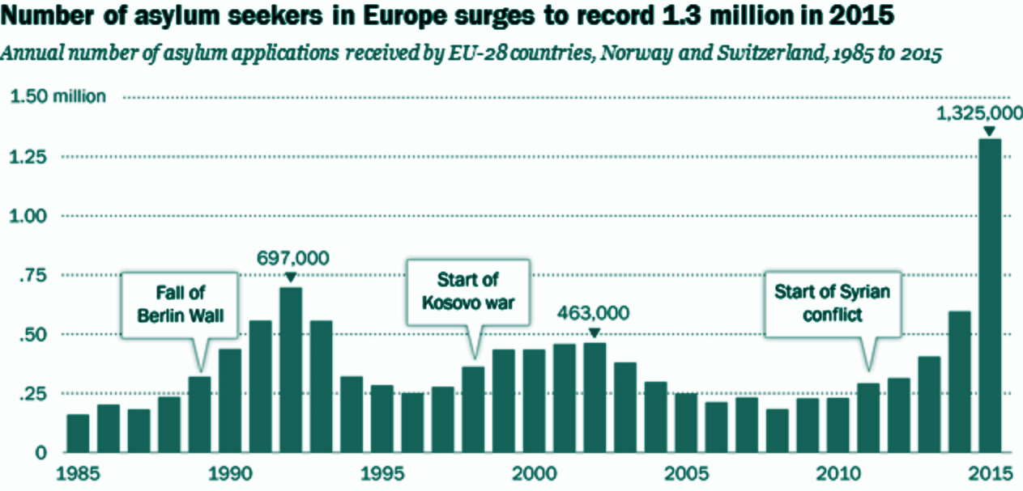
La France est l'un des principaux pays Européens
d'accueil des demandeurs d'asile
France is one of the main European host countries for asylum seekers
Photo by Pew Research Center
Background
Methodology
Findings
Recommendations
Notes:
Liv
France is one of the main host countries in Europe for asylum seekers. The map here shows migrations patterns in Europe that lead to france. The graph on the right shows that Though due to global issues, there have been record breaking numbers of people trying to seek asylum in europe. France is a main host country because there, seeking asylum is a legal right granted by the French law, yet accommodations are not at the standard set by countries like Germany, which offer housing and stipends of money upon arrival. While France is very open, In 2020, France had an overall rejection rate of around 80% for those that applied for refugee status. In addition, there are accounts that France offers poor housing, low social benefits and a long application process. This makes it difficult for new arrivals to receive support or get jobs.

Slide 5
Le soutien social améliore les résultats des nouveaux arrivants
Social support improves outcomes of new arrivals
Social Support
Sense of Solidarity
Mental and Physical Health
Access to Basic Goods
Mutual Aid and Sense of Home
Background
Methodology
Findings
Recommendations
Notes:
Mike
Once new arrivals are in the country, they face a variety of stressful situations that can be alleviated somewhat through social support. This could take the form of governmental support, or support through a new arrival’s community. How can one build a community, though? You could start with mutual aid, also known as reciprocal altruism. A mutual aid network is a horizontally-organized group of people who work together to help each other and improve each others’ situation. However, mutual aid alone does not create a community - a sense of home can make a community complete. A home is a set of everyday practices, beliefs, values, memories, and feelings set against the backdrop of the current political and historical landscape.
Once a refugee for example has that support, many aspects of their life improve. Access to basic goods, their mental and physical health, and their sense of solidarity and community are all enhanced by social support. Their newfound health allows them to pay the favor back through mutual aid, and the community benefits in kind.
Now I’d like to introduce to you an organization that aims to provide that solidarity and sense of home.

Slide 6
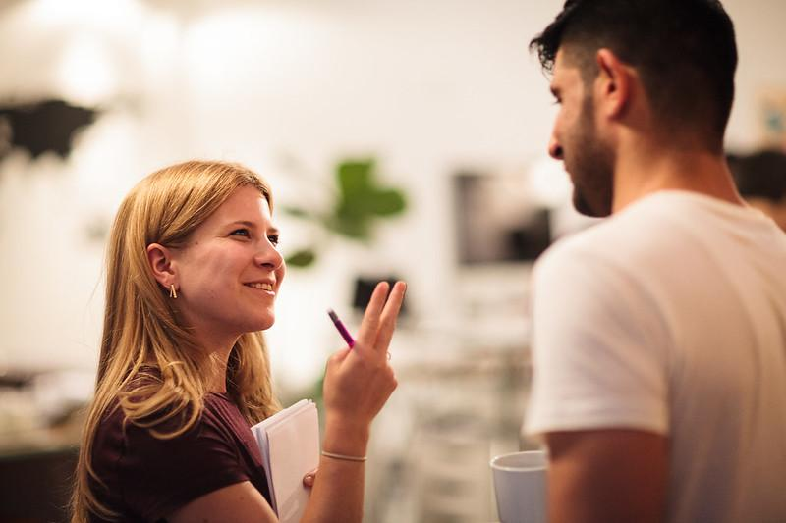
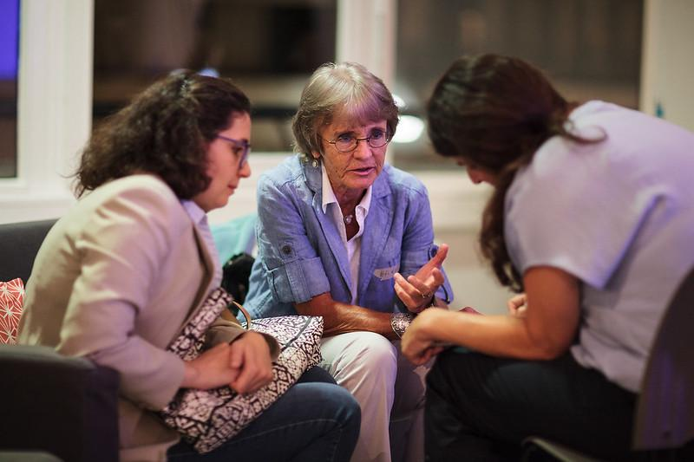
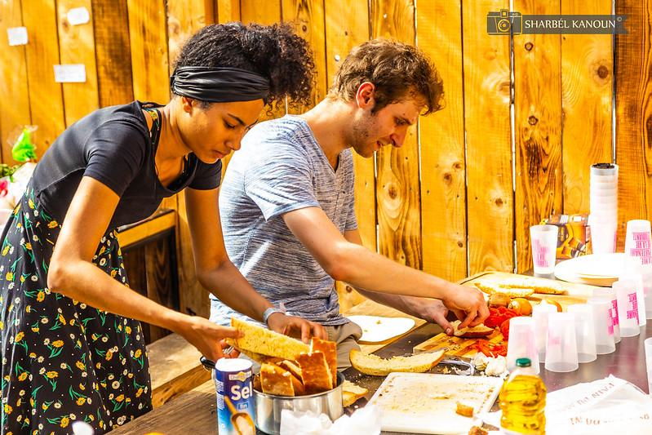
a pour but de promouvoir...
aims to promote...
Autonomie
Autonomy
Inclusivité
Inclusivity
Communauté
Community
Photos by SINGA
Background
Methodology
Findings
Recommendations
Notes:
Mike
Our team has been working with the Lyon branch of the French nonprofit organization SINGA in order to develop a process to design an inclusive space. SINGA as an organization is dedicated to creating an inclusive society for all. SINGA holds some core values which they aim to promote in the lyon community. Firstly they value the autonomy of new arrivals and seek to empower individuals to help themselves and each other. Their entrepreneurship program helps empower community members to achieve stability and independence. Singa also values inclusivity, which aims to bring the individual into the community. This value influences their policy of not asking new arrivals about their experiences prior to arriving in France. This allows individuals to enter the community on their own terms, and be self-defined, rather than defined by their experiences. Lastly, SINGA aims to create a safe and welcoming community for all of the people of lyon. Community members are included in decision making processes, and there are many group events and social activities to grow ties between and within communities.
Before we get into the work we’ve done, we’d all like to introduce ourselves.

Slide 7
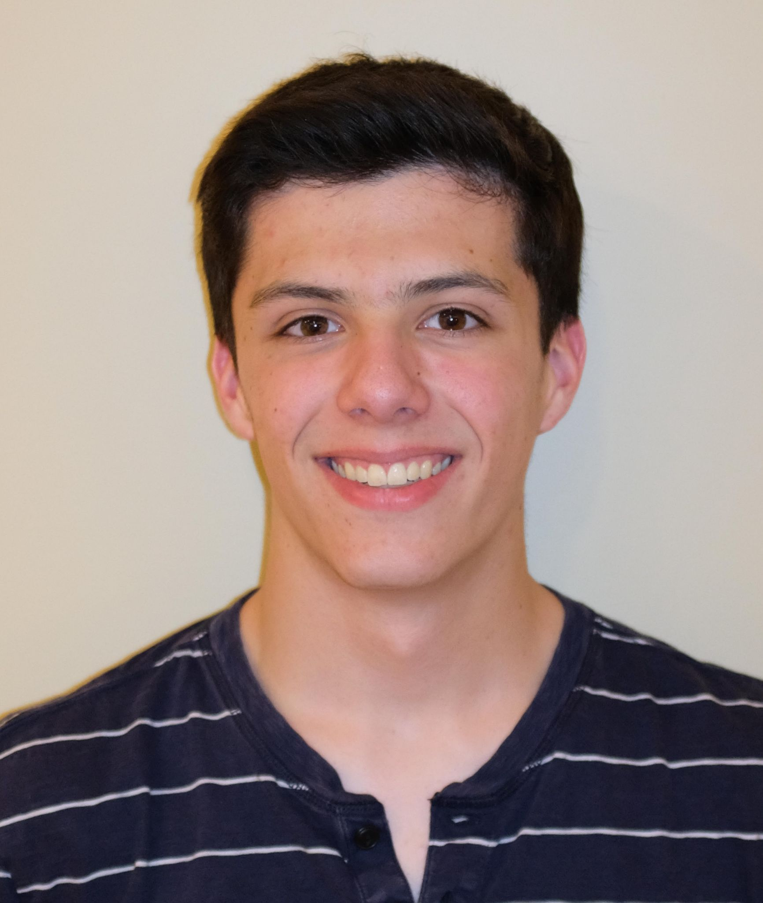
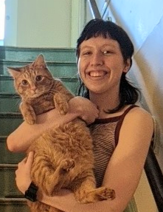
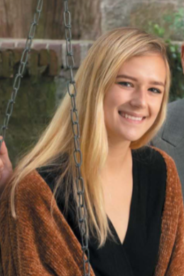
L'équipe
The Team
Mike Viozzi
Mechanical Engineering
Class of 2022
Ezra Vail
Biochemistry
Class of 2021
Liv Petropulos
Biomedical Engineering
Class of 2022
Isabelle Ho
Mechanical Engineering
Class of 2022
Notes:
Je m’appelle Mike Viozzi, j’étudie le génie mécanique, et je suis dans la promotion deux mille vingt-deux.
Je m’appelle Ezra Vail, j’étudie la biochimie, et je suis dans la promotion deux mille vingt-et-un.
Je m’appelle Liv Petropulos, j’étudie la génie biomédical, et je suis dans la promotion deux mille vingt-deux.
Je m’appelle Isabelle Ho, j’étudie la génie mécanique, et je suis dans la promotion deux mille vingt-deux.

Slide 8
Feuille de Route
Roadmap
The Team’s Key Findings
Applying the Process to SINGA
Recommendations for SINGA
Conclusion
Inclusive Design Process and Further Background
Our Project Objectives and Research Questions
What Elements Make a Space Inclusive?
Worcester’s South High Community School
Notes:
Ezra
Voici le feuille de route
We are going to show you how we established this process as well as further recommendations for SINGA that we created.

Slide 9
Understand mission and goals
Know the Organization
Processus Général:
General Process:
Conception d'un Espace Inclusif
Design of an
Inclusive Space
Understand the user’s background
Know the End User
Determine the organization and end users needs
Establish their Needs
Recognize the limitations of the space and how elements of design can satisfy the user’s needs
Be Mindful in Design
Notes:
Isabelle
Using one broad question of What makes a design process inclusive to guide our preliminary research and interviews, nous avons générer la structure d'un processus général que les équipes de conception utilisent pour concevoir des espaces inclusifs
La première étape est de connaître l'organisation, this includes understanding their mission and goals.
La deuxième étape consiste à connaître l'utilisateur final, this means understanding as much as you can, the background of any and all the people who are going to use the space.
La troisième étape consiste à établir leurs besoins, so determining the organization and the end users needs and start brainstorming solutions or elements to meet those needs. At this point it could be helpful to make a list of 3-5 overarching needs and then breaking it down with sub sections that fall under those main 3-5.
La quatrième étape est d'être attentif à la conception, recognizing the limitations of the physical space and how each element of design goes back and satisfies the list of the users and organizations needs. There isn’t really a last step as this is an iterative process, so once the design team feels satisfied with their first design, they should go back through the steps and check, are the designs they came up with connecting with the organization, with the end users, is it meeting the needs list and does it fit within the limitations of the space.

Slide 10
Know the Organization
Determine the organizations and end users needs
Establish their Needs
Know the End User
Establish their Needs
Be Mindful in Design
Research
Direct Involvement
Feedback
I
II
III
Background
Methodology
Findings
Recommendations
Notes:
Isabelle
Nous nous concentrerons sur l'étape 3, établir les besoins de l'organisation et de l'utilisateur final. This step is crucial to foster an inclusive community in any space. The 3 main ideas for this step are: Research, direct involvement, and Feedback. It’s important to research and gain an understanding of the organization and their end user, this is more in depth than step 1 and 2 (know the organization and end user), you really want to see the design process from their point of view, who the organization is catering to and how, and try to anticipate their end users needs. The second idea to establish their needs, is direct involvement with the organization and end user, this is probably the most important aspect when establishing their needs in the design. You must include them, they’re the ones who are going to be using the space and know the most about what they would want from the space. The third aspect is feedback from the end user, this ties it all together. As i mentioned before this whole process is an iterative process, there’s going to changes and adjustments, and they should be from the end users and organization, as this is an inclusive design process.
Later in the presentation, I will walk you through the process we as a team went through to apply the whole process for SINGA. But first, we had to gather more information in order to follow these steps

Slide 11
Gather info on how to generate a framework for a process
Recueillir des informations sur la façon de générer un modèle pour un processus
Interview Nav Anand
Interview similar organizations & WPS Superintendent
Interview SINGA New Arrival
Illustrative Example: South High School
Analyze Existing Spaces
Appliquer les informations recueillies au nouvel espace de SINGA Lyon
Apply the information gathered to SINGA Lyon’s new space
Background
Methodology
Findings
Recommendations
Notes:
Isabelle
As stated in the beginning, our project is to establish a process that can assist in the design of an inclusive space for welcoming new arrivals and the existing community in Lyon, France.
The team created two objectives to structure the project:
Le premier objectif, adressé par les méthodes en haut du diagramme en orange, était Recueillir des informations sur la façon de générer un modèle pour un processus
Le deuxième objectif, adressé par les méthodes au bas du diagramme en sarcelle, était Appliquer les informations recueillies au nouvel espace de SINGA Lyon
The first objective, addressed by the methods on top of the diagram in orange, was (FRENCH)
The second objective, addressed by the methods on the bottom of the diagram in teal, was (FRENCH)

Slide 12
Notre Recherche
What aspects of a physical space are important to consider when thinking about inclusivity?
Research Question 1
How do we translate the feeling of inclusivity to a physical space?
Research Question 2
Background
Methodology
Findings
Recommendations
Notes:
Mike
To direct our research, our team also created two research questions. We’ll be exploring the first research question, which was, “what aspects are important to consider when thinking about inclusivity?” To answer this question, we analyzed existing spaces from around the world and interviewed individuals from a variety of organizations similar to SINGA.

Slide 13
Résumé des espaces analysés
Summary of Analyzed Spaces
Space | Social | Cultural | Accessible
The Friendship Park
Baotou Vanke Central Park
Cowork
DeafSpace
3M Sensory Room
Casa MAC
Kent Timber House
Background
Methodology
Findings
Recommendations
Notes:
Mike
The team has analyzed a variety of spaces including the ones from the last few slides. We identified a few different aspects that an inclusive space can have - social inclusion, cultural inclusion, and accessibility for all were common elements in these spaces. As you can see in the table, the majority of the inclusive spaces we studied had an accessible aspect, while about half had social inclusion, and only one quarter had a cultural aspect. This disparity between the three categories could be due to differing awareness about different types of inclusivity. This may be due to the 7 principles of inclusivity proposed by the Institute for Human-Centered Design, which focus primarily on creating spaces accessible for those with varying body types or those with disabilities. The final three spaces are all private spaces that hold smaller amounts of people. This reduces the need for social or cultural inclusion

Slide 14
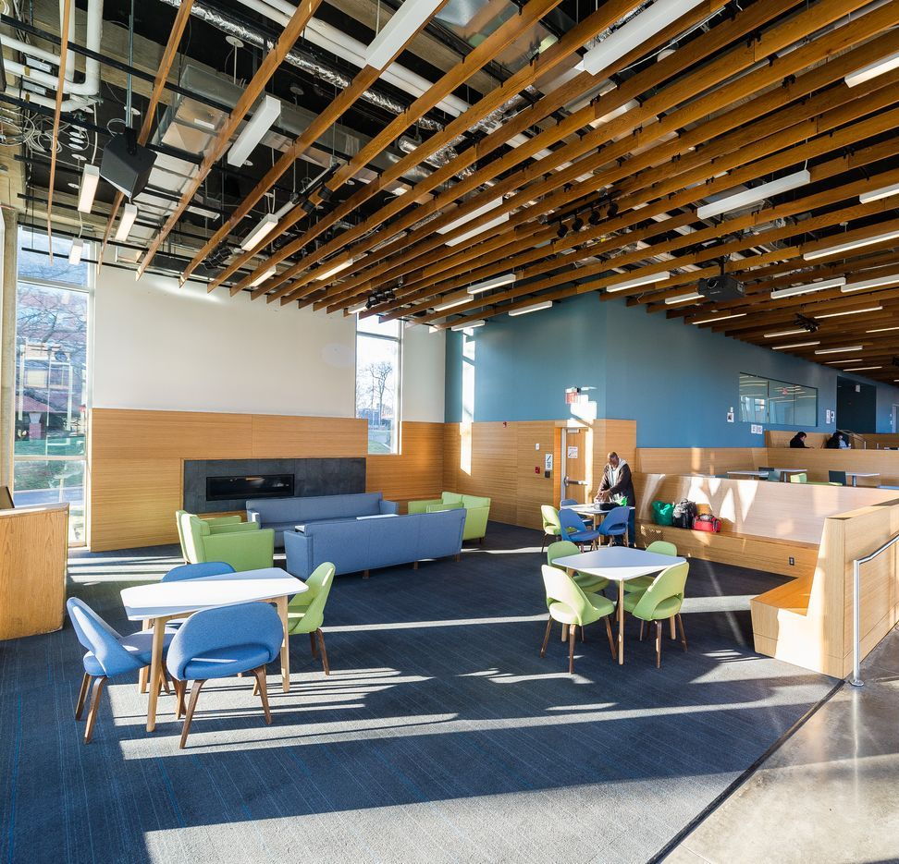
Windows to Allow Maximum Natural Sunlight
Visibility Between Floors
Dark Blue Tones to Contrast Skin Color
Use of Ramps
No Sharp Turns
Horseshoe Design
DeafSpace
Washington D.C.
Pedestals to Place Belongings
Photo by SEGD
Notes:
Liv
cet endroit s'appelle deafspace
Out first visual example of an inclusive space is designed to be accessible to Deaf people. the important design elements to open up the space are the horseshoe design, no sharp turns, and the use of ramps. visibility between floors allows for a better line of sight for those that rely on visual communication. In addition, the space has pedestals to place belongings on to allow people to have free hands to talk. Lastly, the colors of the space and the walls are blue to contrast with skin, making it easier for those who communicate visually.

Slide 15
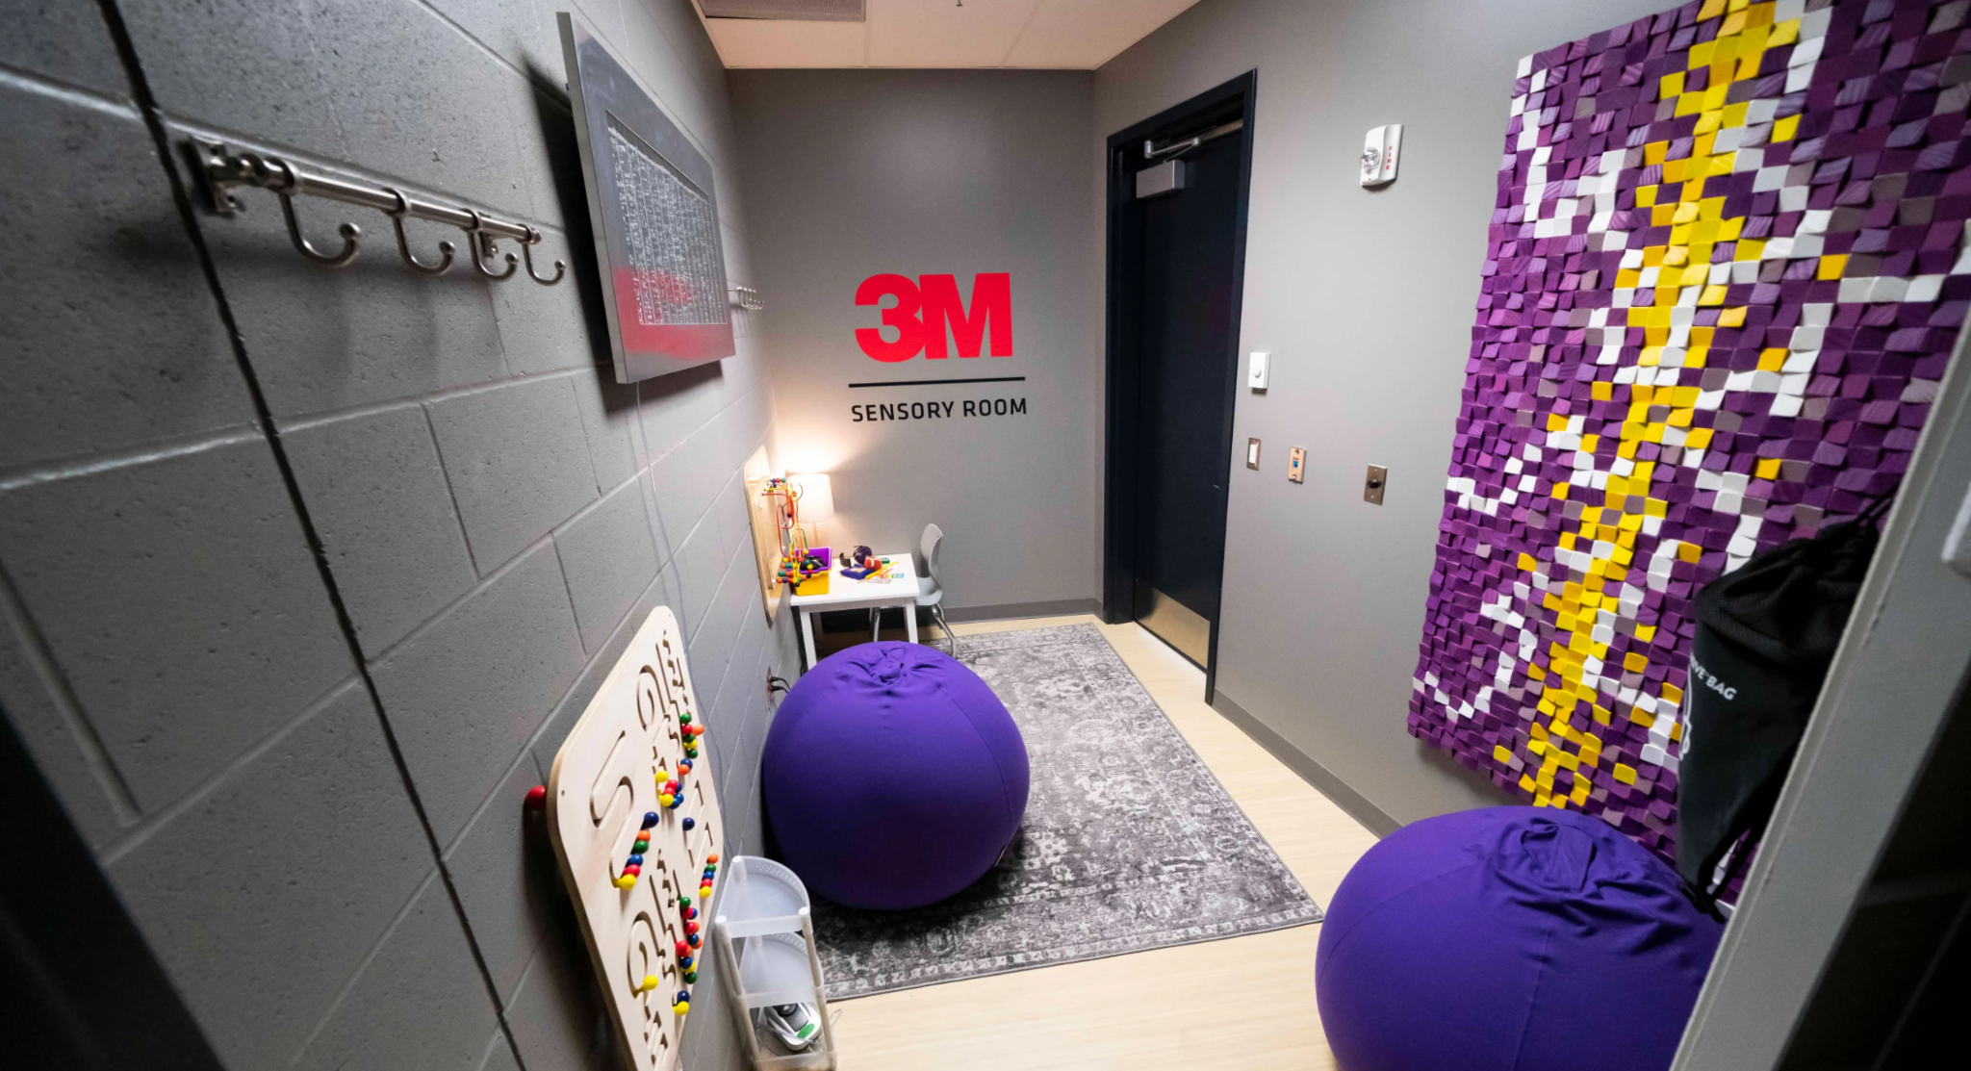
Sensory Engagement Activities
Kulture City:
3M Sensory Room
Minneapolis
Warm and Soft Space
Low to the Ground Seating
Photo by The Vikings
Notes:
Liv
cet endroit s'appelle 3m sensory room
The second example we have here is the 3M sensor room created in cooperation with KultureCity is located in the US Bank Stadium of Minneapolis for people who have cognitive disorders and may want a safe space to escape to. This room is equipped with tactile activities as well as low lighting, soothing sounds, seating that is low to the ground, and decor that is warm and inviting. This is a great example of a private vs. public space, especially one that can accommodate to a large population of people.

Slide 16
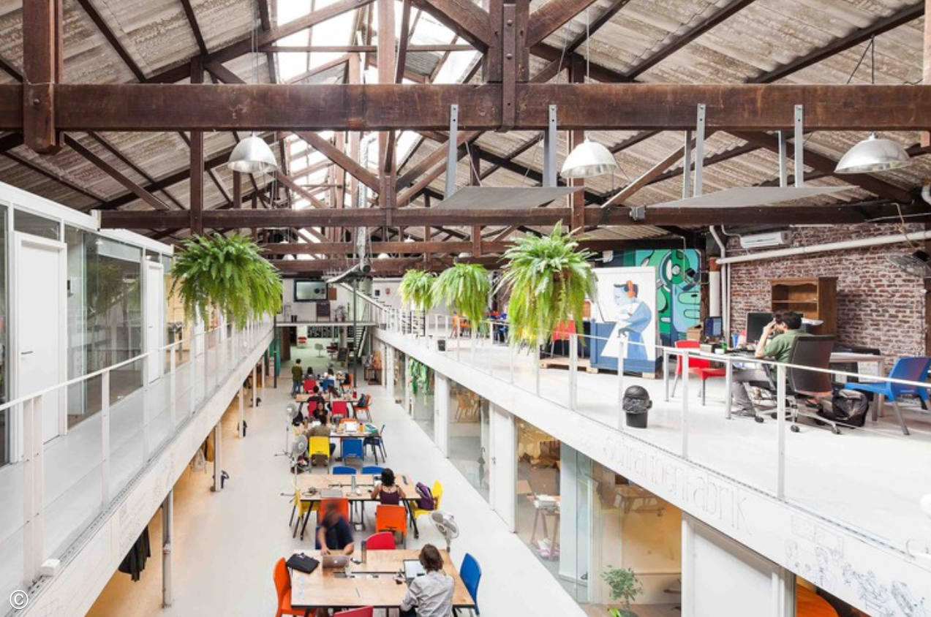
Sinergia Cowork
Uruguay
Community Driven Artwork
Community Engagement Opportunities
Open Seating Design
Private and Public Spaces
Photo by ArchDaily
Notes:
Liv
cet endroit s'appelle cowork
sinergia cowork palermo. This next space is called the cowork, it is used as a contemporary office space that works to promote community and collaboration, also making it a great example of an inclusive space,. They are able to accomplish this by knowing the end user, knowing their needs, and designing the space in a way that satisfies those needs. This space uses open seating that allows people to decide how they sit and interact. In addition, There are many community engagement opportunities offered as people can write on the walls, and use the TV to displays upcoming events and announcements. In addition this space also includes community driven artwork. Most importantly though, this space focuses on the use of both private and public space. This concept is essential to make sure people are comfortable in a space and have a sense of privacy. After analyzing these spaces and answering RQ 1, we moved onto looking at RQ2.

Slide 17
Notre Recherche
What aspects of a physical space are important to consider when thinking about inclusivity?
Research Question 1
How do we translate the feeling of inclusivity to a physical space?
Research Question 2
Background
Methodology
Findings
Recommendations
Notes:
Mike
Our second research question was “How do we translate the feeling of inclusivity to a physical space?”
The team answered this question by looking at the design process used by students at South High Community School here in Worcester to design different features of their new school. We also interviewed a member of the SINGA community in order to get a unique perspective on inclusivity and the needs of the community.

Slide 18
Processus de conception du lycée de South High
South High Student Design Process
Understand mission and goals
Phase I (2018-2019)
Students are gathered & taught about design processes
Areas of the new school are identified to be designed
Know the Organization
Understand the user’s background
Know the End User
Phase II (2019-2020)
Community collaborators work with students
Ideas put forth for the new spaces
COVID-19 pandemic prevents last two community collaborations
Determine the organization and end users needs
Establish their Needs
Phase III (2020-2021)
Goal was to work with professional artists to realize students’ ideas
Full completion of the project delayed due to the pandemic
Recognize the limitations of the space and how elements of design can satisfy the user’s needs
Be Mindful in Design
Photo by WPS
Photo by NeONBRAND on Unsplash
Photo by Ameen Fahmy on Unsplash
Notes:
Ezra
Pour le processus de conception du lycee de south high
One of our keystone interviews for this project was with the designer Nav Anand, and focused on her involvement in a project to bring students into the design process for the new South high community school building here in worcester. In phase one, which was two years ago, students were gathered and taught about the fundamentals of design. Initially, students needed to be provided with the opportunity, resources and skillset needed to create and innovate to take part in creating the new SH.
they had no idea how to move forward with the project because they’d never had their opinions and ideas valued for a real world project, and were used to being told what to do. At the end of phase one, 5 areas of the school were identified to be areas that the students could design. Phase two was last year, and collaborators were brought from different areas of the community such as city government, local architects and artists, the historical society, and more.
The goal was for professionals from the community to help the students plan and realize their ideas, however when the pandemic hit they didn’t get to finish their last collaborations. The aim of phase three, this past year, was to implement the students ideas and complete the design process, however very little was able to be completed so far.
These phases broadly relate back to the general design process we outlined in the beginning. The first phase is knowing the organization and end user. The second phase is knowing the end user and establishing their needs, as we had detailed before using research, direct involvement and feedback. The third phase is being mindful in the design, using professional artists to realize the students ideas…
Besides the phases design process, we also learned a lot from south high example...

Slide 19
Leçons à retenir de South High Community School
Key Takeaways from South High Community School
01
Favoriser une culture qui célèbre la diversité
02
Offrir des conseils et du mentorat, mais pas de directives
03
Encourager les jeunes à participer
04
Permettre différents niveaux et modes d'implication
Background
Methodology
Findings
Recommendations
Notes:
Ezra
Voici quelques lecons a retenir de south high community school
Here are some takeaways we learned from the example of the south high community school about how to design an inclusive space.
First is to foster a culture that celebrates diversity, because South high draws its strengths from having a close knit community that values different perspectives, and this is what empowered students to feel like they could take action.
Next is to offer guidance through the process, but not be directly telling people what to do. Students initially struggled to come up for ideas with this project because they are used to only being creative within the bounds of an assignment, but after learning more about how design works they drove the project themselves.
The third takeaway is to encourage youth participation. This project at south high as well as others there such as the youth philanthropic council and the fully student run clothes donation nonprofit show that young people are just as capable of involvement and generating ideas, and would be a valuable voice to have during an inclusive design process.
Lastly, it is important to allow for different levels of commitment and ways to get involved. We found that participation in the design process at south high dwindled over the years, and many students had to choose between the project and other extracurriculars. Having ways of getting involved that are low commitment and can be done seasonally would help sustain involvement and energy for the design process.

Slide 20
SINGA aims to promote inclusivity and community building
Connaître l'organisation
New arrivals and existing Lyon community
Connaître les utilisateurs
Établir leurs Besoins
Employment
Housing and Administrative Support
Language Support
Social and Cultural Support
Welcoming Atmosphere
Permeable barrier
Flexibility
Wayfinding
800 sq. meters
Soyez attentif à la Conception
Background
Methodology
Findings
Recommendations
Notes:
Isabelle
Maintenant que nous vous avons montré un peu ce que nous avons appris, je vais vous expliquer le processus que nous avons suivi en tant qu'équipe pour appliquer ces étapes du processus général précédemment évoqué à SINGA, notre organisation partenaire et leur espace idéal.
Les deux premières étapes : connaître l'organisation et connaître l'utilisateur final, SINGA l'a déjà fait, ils connaissent leur propre organisation et ils connaissent leurs utilisateurs finaux : les nouveaux arrivants et la communauté environnante existante à Lyon.
The third step, the one we mainly focused on, is to establish their needs, we determined 5 main needs that were informed by SINGA and our own background research to guide the design of the space for the organization and end users, all of these needs are more abstract ideas that we brainstormed physical designs or elements that help to fulfill them.
The first being employment, and the second being housing and administrative support, as an organization that has been around since 2012, they have a lot of knowledge and experience in helping new arrivals through difficulties they may face and these needs can be met by having a combination private and public areas as shown in the previous Cowork space example. For SINGA, these bigger public areas can be used to run and gather their current entrepreneurship programs as well as other new programs they develop while the private spaces can be used to discuss more private matters of have small meetings. The third need we identified was language support, there are a multitude of new arrivals from different countries, most don’t speak english and may not even speak french. So having signs in multiple languages or images can be very helpful. The fourth need we identified was social and cultural support, we want to make sure everyone who comes into the space feels that they can see a support system there for them, this can be done with good communication, inclusive kitchens with multiple fridges to support different religions diets and personal dietary needs as well as a large collection of different cookware and spices for different cultures cuisines, or even a bar where people can relax and connect at. The fifth need we identified was that the space must have a welcoming atmosphere, this can be achieved a lot of different ways, from bring family friendly with private spaces as nurseries or daycares, as well as interesting textures or colors like shown in the Deafspace and US Bank Stadium examples.
As you can see, a lot of these needs designs can overlap or be multipurpose.
The fourth step is to be mindful in design, some specific aspects we discussed were that it must have a permeable barrier, so the exterior should mark the border between communities without being a barrier to movement. Additionally the space must be flexible and allow room for improvement and change as needs change. Another element we discussed was wayfinding, this pertains to the layout of the space, it must have a logically layout so people may find their way through it easily and naturally. As we are remote, we were unable to see the current space SINGA has put a bid in for however we do know it is 800 sq meters which is about 1 and a half football fields. This is a large space and definitely has the capability to fulfill a lot of needs with the right designs.
Again, as this is an iterative process, this is a beginning design run through done by us for SINGA’s space, we have a lot of recommendations and ideas but they should be run through the process multiple times to be sure that the designs brainstormed here or in the future are connecting with the organization, end users, they meeting the needs list, and fit within the limitations of the space. That being said, we do have some specific recommendations for SINGA

Slide 21
Recommandations pour SINGA
SINGA-Specific Recommendations
Social Incl.
Cultural Incl.
Inclusive crèche
Industrial kitchen
Space for donations
Spaces for religious activities
Community-
driven artwork
Open co-working space
Community engagement area
Individual workspaces
Flexible space
Natural lighting
Universal Signage
Circular/horseshoe tables and spaces
Ramps & elevators
Spaces to de-stress
Tactile communication
Accessibility
Background
Methodology
Findings
Recommendations
Notes:
Mike
We have listed here most of the recommendations we have made for SINGA. Recommendations that have been underlined have also been found in many of the already existing spaces we analyzed. We’ll go into some more depth on those underlined recommendations next.
Adding in ramps wherever possible is a great way to include those who use mobility devices or the elderly. They reduce the barrier of entry of these groups into the space and in turn show that they are welcome in the community. Elevators have this same effect, and allow these groups easier access to non-ground-level floors. However, if the space SINGA is looking at doesn’t have an elevator, it is likely cost-prohibitive to install them without any monetary support from partners or the French government.
Heavy use of natural light can be beneficial in a variety of ways. Within the context of DeafSpace which we explored earlier, lots of natural light ensure that everyone who uses the space can everyone else. This is helpful when you can only talk to a person you can see. Natural light also makes a space more human when compared to the sterile blueish light emitted by some bulbs. The more yellow colors of natural lighting can be easier on the eyes and have a soothing effect even when replicated by people.
Tactile communication can describe a wide variety of interventions in a space. Braille is a form of explicit tactile communication that encodes words as a series of raised dots that a blind person can read with their hands. Tactile communication can take a variety of forms, though. If you’ve ever entered the street from the sidewalk in the United States, you’ve seen those yellow plates with the raised bumps on them. This is actually an implicit signal to blind people that they’re entering the street from a curb. Flooring texture can be used in this way to provide context clues about the uses and features of a space to anyone who uses it.
Community-driven artwork is another common feature of inclusive spaces. Artwork provides an expressive, human quality to a space, and can communicate where words fail. This becomes even more meaningful when a community decorates their own space. The students of South High attempted to distill their school’s unique culture into the artwork they created, and in the process made their new school truly theirs.
Finally, we believe the space should be flexible to some degree. The struggles people deal with can change quickly, and if this SINGA is to meet these needs, the space must be able to adapt just as quickly. We recommend that a mix of public and private spaces be set aside and not given an explicit purpose by SINGA. Rather, these spaces’ uses and designs should be decided by the community in order to best meet their most pressing needs. Besides making SINGA adaptable to changing conditions, these spaces offer an opportunity for community members to physically shape their surroundings, which deepens their connection to both the space and to each other.

Slide 22
Conclusion
No Absolutes
Il n'y a pas d'absolu dans la conception d'un espace inclusif - chaque processus doit être flexible
Balance
Les besoins de tout le monde ne peuvent pas être entièrement satisfaits tout le temps, donc un processus de conception doit continuellement équilibrer ces besoins
Framework
Le processus et les informations que nous avons recueillies fourniront un cadre pour le nouvel espace de SINGA
Notes:
ezra
Here are some of the main conclusions we took away from this project and the process we designed.
First, there are no absolutes when it comes to designing an inclusive space- every process must be flexible to meet the needs of their community.
Next, not everyone’s needs can be fully met all the time, so one of the main challenges is to balance everybody’s needs continuously.
Lastly, we believe that the process we have created and the information and suggestions we have gathered will provide a solid framework for SINGA to use to help them develop their new space.

Slide 23
Remerciements
Acknowledgements
The team would like to thank:
Justine Petit, Bonney Magambo, and all the members of the SINGA community
Dr. Tiffiny Butler, Mia-Kay Fuller, Rachael Heard, and Arnold Lane Jr.
SINGA
WPI’s Office of Multicultural Affairs
Nav Anand and Maureen Binienda
Charles Baldwin
Expert on Inclusive Design and WPS Superintendent
Massachusetts Cultural Council
Notes:
Ezra
We’d like to thank a few people who gave their time and energy to the project, it wouldn’t be possible without them.
First, we’d like to thank Justine and everyone at SINGA.
We’d also like to thank the members of WPI’s office of multicultural affairs, as well as charles baldwin of the mass cultural council.
Finally, we would like to thank Nav Anand for her insight on the design process and superintendent of worcester public schools maureen binienda for her help learning about south high.

Slide 24
Merci de votre attention!
Questions?
Notes:
Isabelle
Ca c'est le fin de notre présentation sur Établir un Processus pour la conception d'un Espace Inclusif
Merci de votre attention, est ce que vous avez des questions?
That is the end of presentation on Establishing a Process for the Design of an Inclusive Space, thank you for your attention, does anyone have any questions?

Slide 25
References (pt 1)
Azmat, F., Fujimoto, Y., & Rentschler, R. (2015). Exploring cultural inclusion: Perspectives from a community arts organisation. Australian Journal of Management, 40(2), 375-396.
Boenigk, S., Fisk, R., Kabadayi, S., Alkire, L., Cheung, L., Corus, C., ... & Smidt, N. (2021). Rethinking service systems and public policy: a transformative refugee service experience framework. Journal of Public Policy & Marketing, 40(2), 165-183.
Brun, C., & Fabos, A. (2015). Making homes in limbo? A conceptual framework. Refuge, 31(1), 5+. Gale OneFile: Psychology.
Carponen, Claire. (2020) 700-Year-Old Timber-Frame Manor in Kent Offers Historic Hideaway. Mansion Global, Mansion Global, www.mansionglobal.com/articles/700-year-old-timber-frame-manor-in-kent-offers-historic-hideaway-213916.
Casa MAC by So & So Studio UG; Italy. (2021), BigSEE, bigsee.eu/casa-mac-by-so-italy/.
Create Inclusive Spaces and Climate. (2020) Diversity, Equity & Inclusion, diversity.ucdavis.edu/how-do-i/create-inclusive-spaces-and-climate.
Goodman, S., & Speer, S. A. (2007). Category use in the construction of asylum seekers. Critical Discourse Studies, 4(2), 165-185.
Green Lungs in Urban Areas. (2020) The Finest Magazine, thefinestmagazine.com/green-lungs-among-urban-areas/#:~:text=Baotou%20Vanke%20Central%20Park%2C%20China&text=Located%20on%20the%20land%20with,for%20both%20adult%20and%20children.
Institute for Human Centered Design. (n.d.). Inclusive Design Principles. https://humancentereddesign.org/inclusive-design/principles
Kaushal, N. (2019). Refugees and Discontent. In Blaming Immigrants (pp. 138–151). Columbia University Press; JSTOR. http://www.jstor.org/stable/10.7312/kaus18144.9
Kiela, M. (2020). The neurological implications of forced migration (Publications No. 3656867). [Bachelor’s Thesis, University of Arizona]. Social Science Research Network https://papers.ssrn.com/sol3/papers.cfm?abstract_id=3656867
Landman, K. Inclusive public space: rethinking practices of mitigation, adaptation and transformation. Urban Des Int 25, 211–214 (2020). https://doi.org/10.1057/s41289-020-00136-4
Langenkamp, A. G., & Carbonaro, W. (2018). How school socioeconomic status affects achievement growth across school transitions in early educational careers. Sociology of Education, 91(4), 358-378. https://www.jstor.org/stable/10.2307/48588644
Laurito, A., Lacoe, J., Schwartz, A. E., Sharkey, P., & Ellen, I. G. (2019). School climate and the impact of neighborhood crime on test scores. The Russell Sage Foundation Journal of the Social Sciences, 5(2), 141-166. https://www.jstor.org/stable/10.7758/rsf.2019.5.2.08
Minnesota Vikings. (2019, August 15). Vikings, MSFA announce 3M sensory room at U.S. Bank Stadium. www.vikings.com/news/sensory-room-us-bank-stadium-hosts-first-guests.

Slide 26
References (pt 2)
O’Donnell, T. (2017). Strategic Vision Data Appendix. Diversity, Equity & Inclusion. https://diversity.ucdavis.edu/data
Peters, Craig. (2020) 3M Sensory Room at U.S. Bank Stadium Hosts First Guests, 3M,
Pryor, L., Lioret, S., van der Waerden, J., Fombonne, É., Falissard, B., & Melchior, M. (2016). Food insecurity and mental health problems among a community sample of young adults. Social Psychology and Psychiatric Epidemiology, 51, 1073-1081. https://doi-org.ezpxy-web-p-u01.wpi.edu/10.1007/s00127-016-1249-9
Rizo-Corona, L., Leal-Pérez, A., Rey-Galindo, J., Acevez-González, C., & González-Muñoz, E. (2020). Development for an anthropometric protocol for wheelchair users: Guiding the decision-making for designing inclusive spaces. In Di Bucchiano, G. (Ed.), Advances in Design for Inclusion (Vol. 954, pp 196-205). Singer. https://doi.org/10.1007/978-3-030-20444-0_19
Roy, P. (2019). Community gardening for integrated urban renewal in Copenhagen: In C. Certomà, S. Noori, & M. Sondermann (Eds.), Urban gardening and the struggle for social and spatial justice (1st ed., pp. 91–107). Manchester University Press; JSTOR. http://www.jstor.org/stable/j.ctvnb7rfm.14
Sánchez, Daniel. (2015), Friendship Park / Marcelo Roux + Gastón Cuña. ArchDaily, ArchDaily,www.archdaily.com/770600/friendship-park-marcelo-roux-plus-gaston-cuna.
Sendra, P., & Sennett, R. (2020). Designing disorder: Experiments and disruptions in the city. Verso.
Shultz, C., Barrios, A., Krasnikov, A. V., Becker, I., Bennett, A. M., Emile, R., ... & Sierra, J. (2020). The global refugee crisis: pathway for a more humanitarian solution. Journal of Macromarketing, 40(1), 128-143.
Sinergia Cowork. (2017), Included.co, Sinergia Cowork. included.co/join/sinergiacowork/.
SINGA. (n.d.). Qui sommes-nous?https://singalyon.fr/notre-action/
Soriano, E., & Cala, V. C. (2019). What Attitudes Toward Refugees Do Future European Teachers Have? A Comparative Analysis between France and Spain. Sustainability, 11(11). Publicly Available Content Database; SciTech Premium Collection. https://doi.org/10.3390/su11113066.
Tay, A. K., & Silove, D. (2021). Screening and assessing refugee mental health needs. In Aten, J. D., & Hwang, J. (Eds.), Refugee Mental Health (pp. 167-190). American Psychological Association. https://www.jstor.org/stable/j.ctv1f70m24.10

