Slide 1
Revamping the Customer Relations Management System for the Somali Youth Development Resource Centre (SYDRC)
Matthew Dzwil, James Hammel, Bradley Markiewicz, Matt Worzala
Notes:
We aimed to work on the implementation of the CRM software, in this case Substance Views for the SYDRC

Slide 2
CRMs are valuable to non-profits
Percentage of charities that use CRM software
100
%
55
%
79
%
71
%
31
%
11
%
Micro
Small
Medium
Large
Major
Supermajor
(Under £10k income)
(£10-£100k income)
(£100-£1m income)
(£1m-£10m income)
(£10m-£100m income)
(Over £100m income)
Notes:
James - CRMs are
CRMs are valuable tools for nonprofits - centralize and keep track on information throughout an organization.
Majority of Medium-Supermajor size nonprofits use CRM software.
Over 80% of nonprofits say that CRM software saves them time.
Over $8 return on investment.

Slide 3
SYDRC data is decentralized
Notes:
Bradley- The CRM that the SYDRC uses is Substance Views though its lackluster technical support and unintuitive design led to workflows in SYDRC using different applications to gather feedback, organize large amounts of data, or to write down important information. Spreading this information among these applications caused the data to be decentralized and duplication of work which could take time away from working with clients and activities in the organization. We wanted to move as much of these tasks to Views from google forms to the questionnaires functionality and summaries to analyze data that is collected. Moving to Views offers data centralization and less confusion among staff members when using one app.
Disorganization
Duplication of work
Non centralized
Hard to summarize info

Slide 4
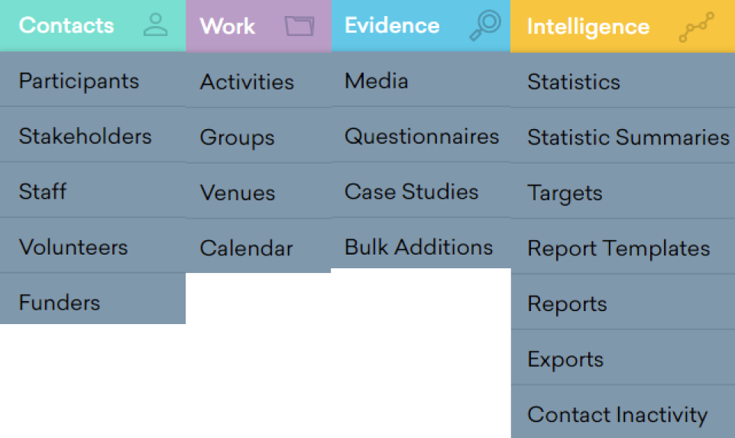
What is Views?
Notes:
James - Views
4 main Categories:
Contacts
Work

Slide 5
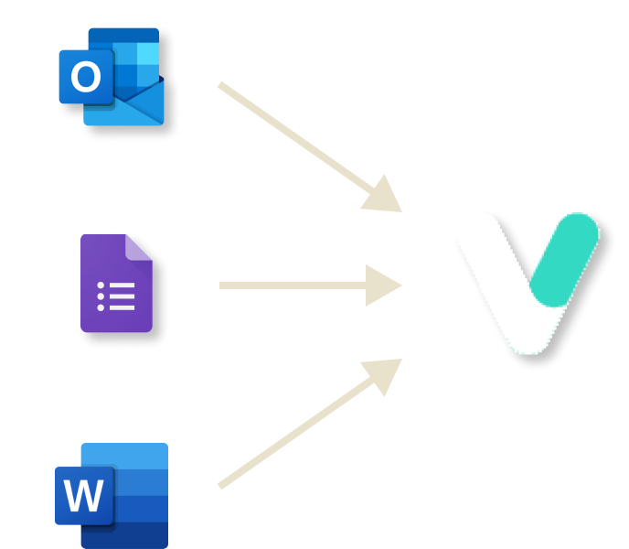
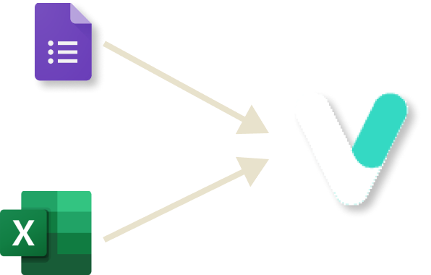
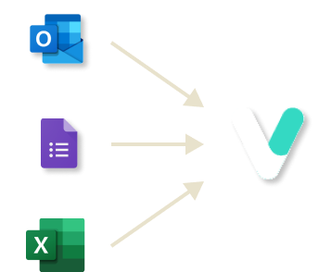
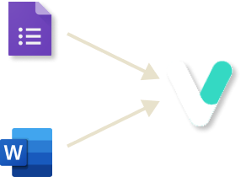
SYDRC Departments
Case Work
Youth Services
Administration
MPower
Notes:
Bradley-Within the SYDRC there are 4 main departments and each has its own workflow that requires different parts of the Views software. To determine how they used Views we originally sent out a survey asking about your use case, then informal interviews to gather more information on there current workflow and what might be able to be moved over to Views. And as we continued to find ways that Views can work in the SYDRC we met with staff weekly to present our findings and get feedback on our changes. On the slide is a brief graphic showing each department and the applications previously used and how they have moved towards using Views more independently.

Slide 6
Old Case Work

Slide 7
New Case Work
Notes:
Enquiry form went from word to Questionnaire
Ant staff member will be able to fill out a questionnaire in Vies
It can be linked to a participant
Stats and summaries can be made on it
Case Work Form went to Questionnaire
Linked to a participant
Can sort by open and closed
Easy Statistical Summaries

Slide 8
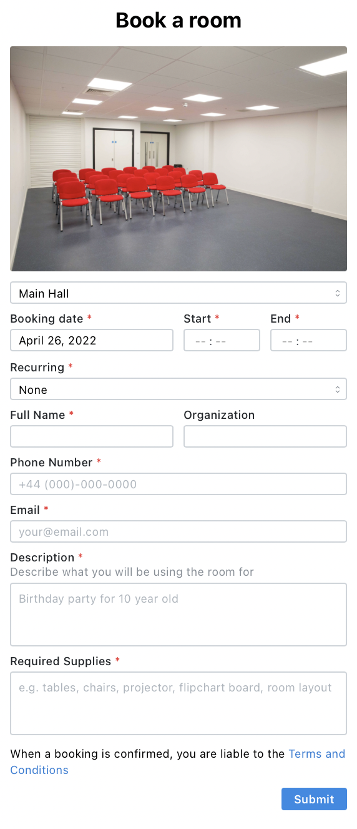
Booking System
>
https://SYDRC.pages.dev/

Slide 9
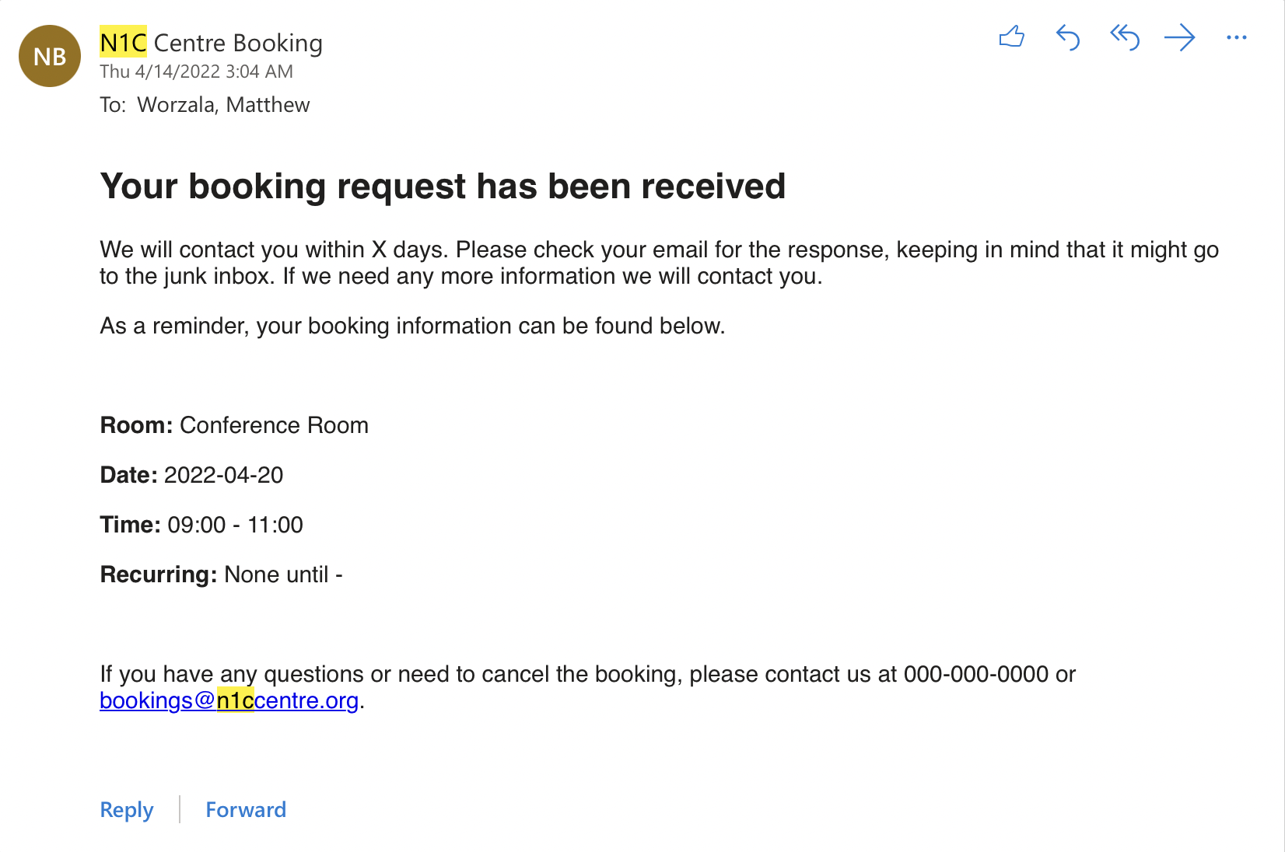
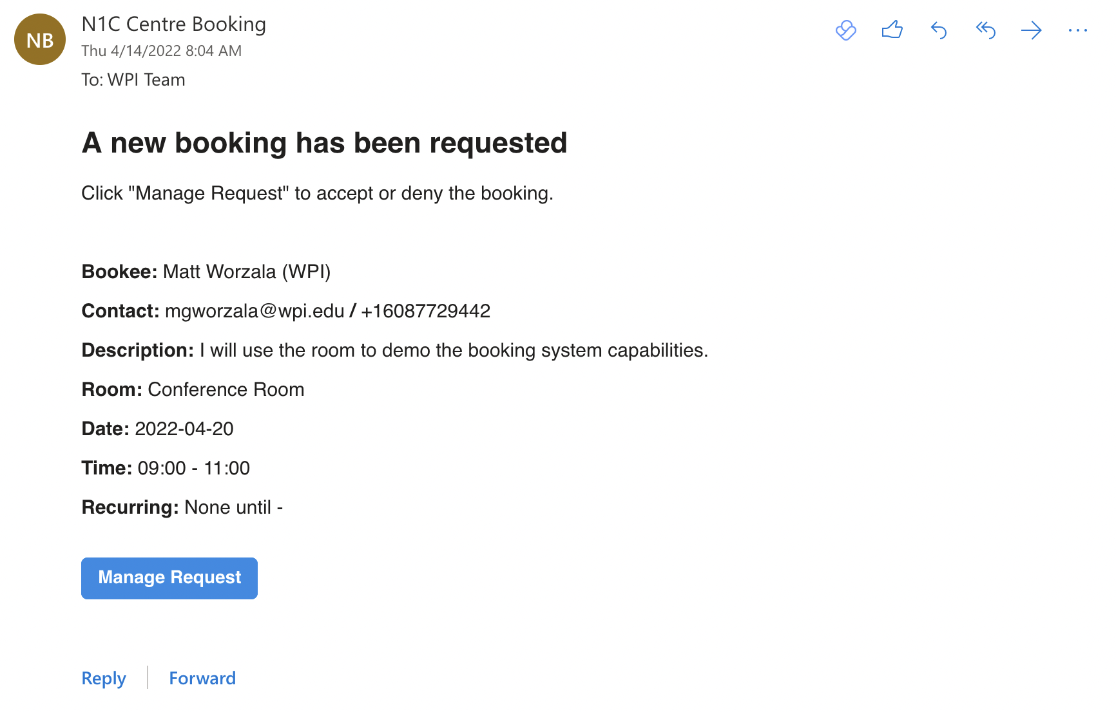
Booking System
Client Email
SYDRC Email

Slide 10
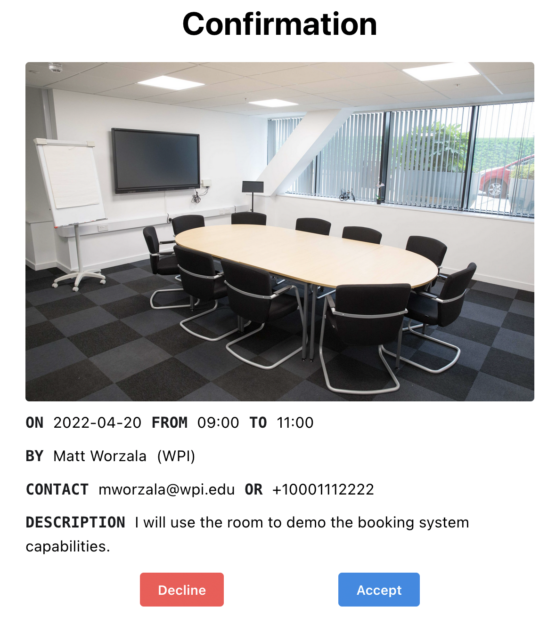
Booking System

Slide 11
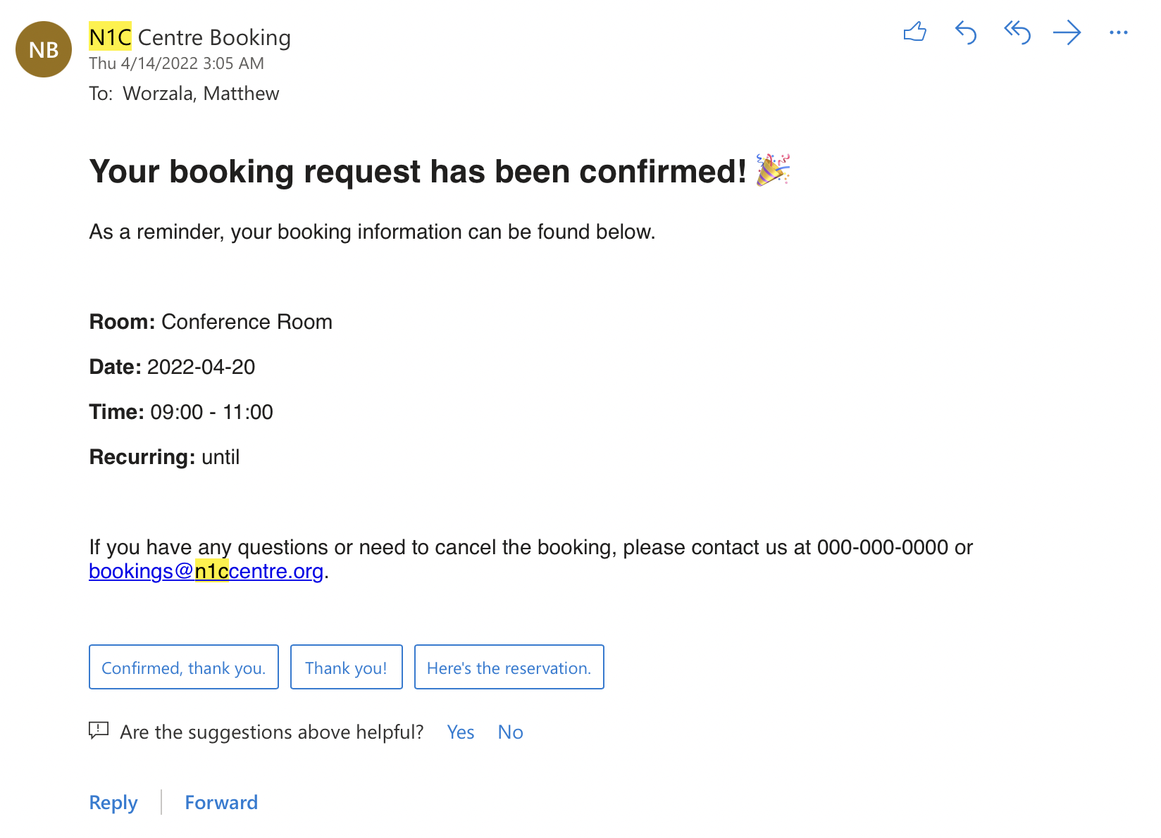
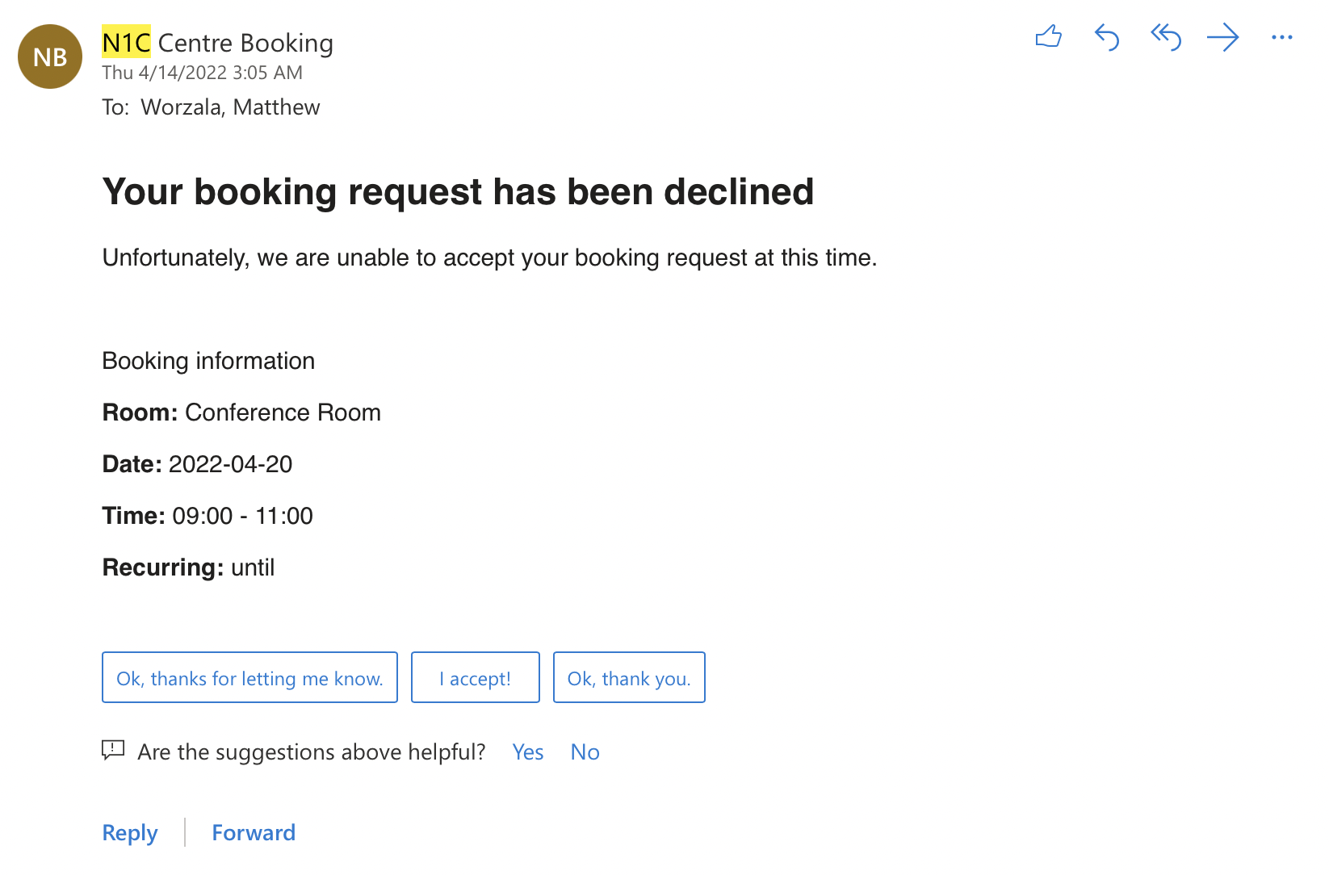
Booking System
Confirmed
Declined

Slide 12
Booking System
Notes:
Worzala

Slide 13
A Guide to Views
Notes:
James. Show one of his videos I guess

Slide 14
Special Thanks
Abdiwahab Ali
Isahaq Abdikarim
Abdilatif Abdulkadir
Abdikadir Ahmed
Mohamed Abdi
Dominic Golding
Lorraine Higgins

