Slide 1
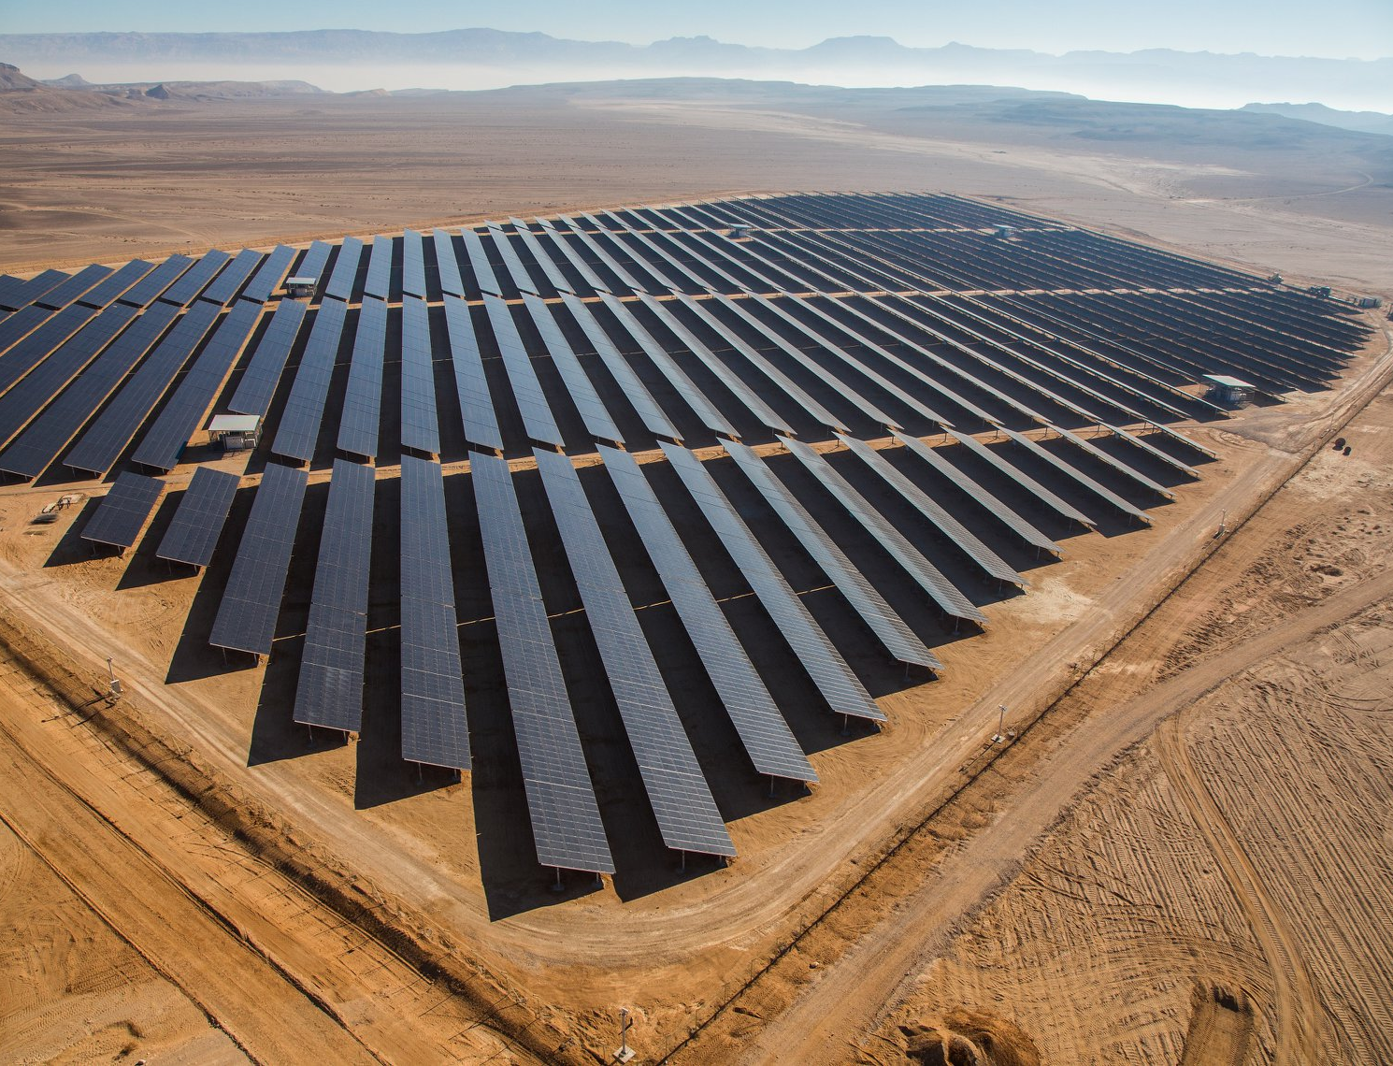
A video Showcase of Cleantech Innovations in the Arava
Elena Bachman, Stephen Davis, Daniel Rabinovitz, and Yiyi Wu
Notes:
Elena: We are making short videos to inform cleantech industry professionals of essential but underrepresented topics. These videos will be distributed throughout the by our sponsor, leading to a better informed cleantech industry in Israel.

Slide 2
Eilat-eilot
Our sponsor company
Notes:
Stephen:
Our sponsor, Eilat-Eilot, is a renewable energy company based in the southern Arava desert region of Israel. Sponsor will connect us to experts on video topics. They also plan to create an international knowledge center in this region for research and development center on clean tech. We'll be assisting them in creating videos for this knowledge center (newsletter and social media)

Slide 3
Project Overview
WHAT IS CLEANTECH?
Food
Energy
Water
PROBLEM STATEMENT
Cleantech in the Arava has developed quickly in the last decade. There are few resources online that showcase the unique perspective the region provides on implementing cleantech.
Notes:
Elena - The Arava region is deeply affected by climate change and is reliant on unstable seasonal industries. Eilat-Eilot has embraced cleantech as both an environmental and economic benefit. While an established local knowledge base exists in the Arava community, there are few resources online that showcase the unique perspective this arid region provides on both social and technological aspects of implementing cleantech.
Yiyi – Cleantech refers to environmentally friendly and sustainable technology (examples: renewable energy sources, water filtration, etc.).
Food, Energy, and Water are the three main subcategories of Eilat-Eilot's purpose

Slide 4
Project Goal
To inform Israeli cleantech professionals about innovations in the Arava region through videos, and to establish a process for the creation of future content after our project is over.
Notes:
[Daniel]

Slide 5
Our Objectives
1
2
3
Investigate cleantech innovations and their impact in the region
Produce short, informational videos
Develop a guide for others to create similar videos in the future
Notes:
Yiyi

Slide 6
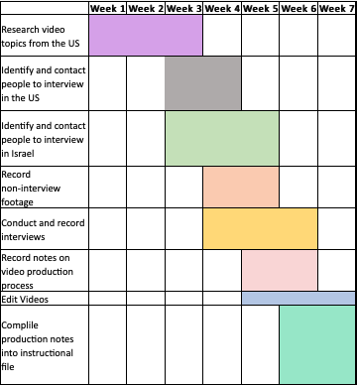
Project Timeline
Gantt chart of action items by week
Notes:
[Daniel]
This is our proposed work timeline

Slide 7
Three video topics
01
03
The Circular Economy
Off-grid tech for the developed world
Clean energy as an economic pillar for Kibbutzim
02
Notes:
Yiyi:
Reason:
Other topics that were given to us fall under these three topics
Taking staying in the US for a certain amount of time into consideration
Easy to research while staying in the US

Slide 8
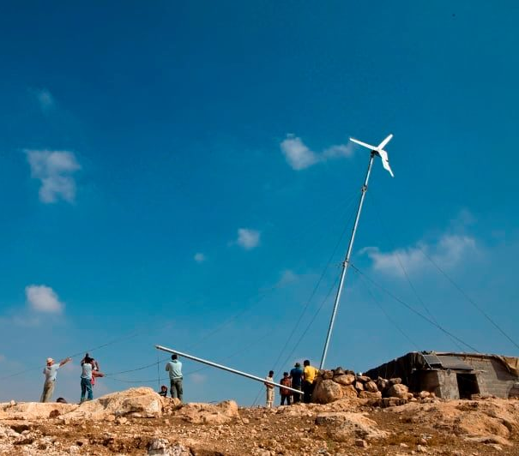
01
Best Practices

Slide 9
Tell the Story
Short video structure recommended by the WPI Global Lab
Timeline | Content
0:00-0:15 | Why?
0:15 – 0:30 | Who?
0:30 – 1:00 | How?
1:00 – 1:15 | Overview
Notes:
[Daniel]
Why should they care about my thing?
Who should care about my thing?
How do they do/use the thing?
Overview: general applications of thing

Slide 10
Consider the Audience
CLEANTECH WORKERS
IN THE OFFICE
Already have background knowledge on the topic
People watching videos at work rarely turn on the sound
Notes:
Elena and Stephen (unique audience)

Slide 11
Make it Accessible
Reduce the amount of thinking required to make sense of the content (cognitive load)

Slide 12
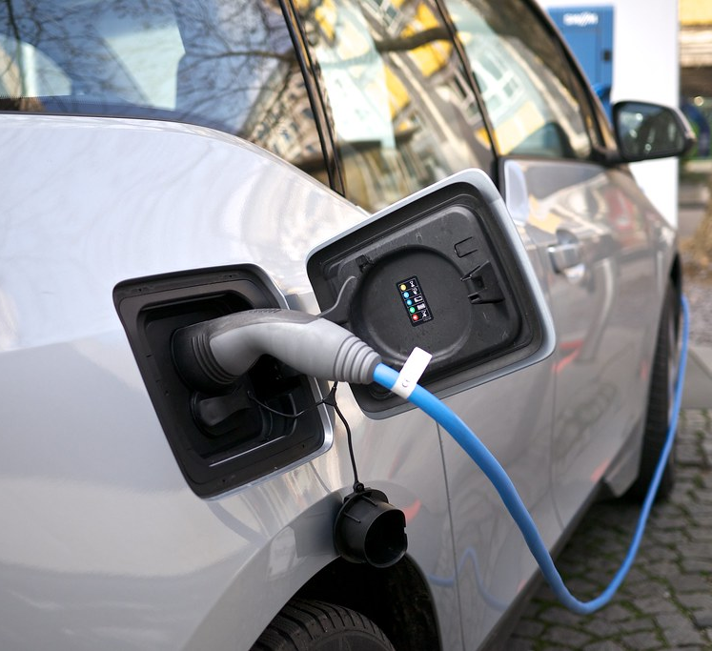
02
Videos

Slide 13
Applications of Circular Economy on a Community Scale
Circular Economy.mp4

Slide 14
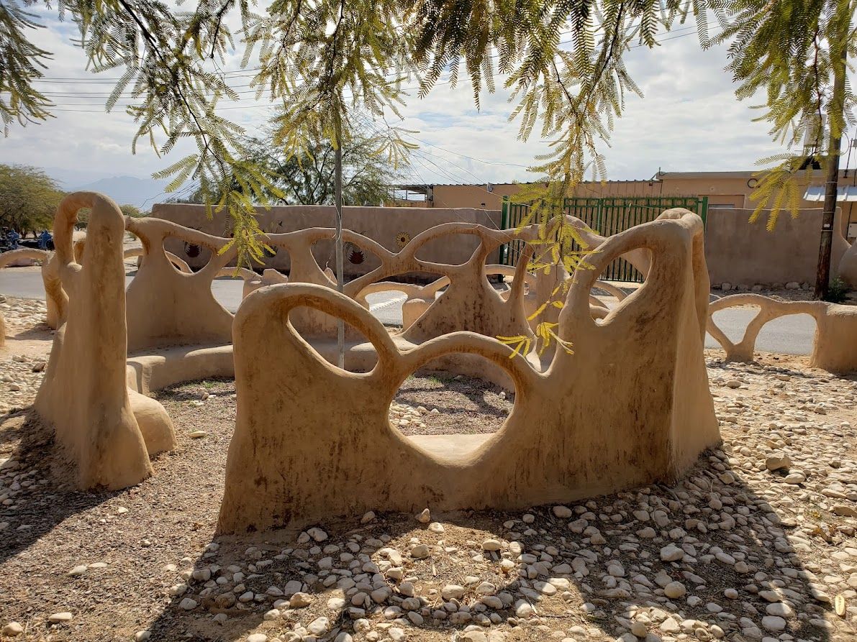
Circular Economy Considerations
The transition to circular economy requires an initial investment. The larger the scale, the more new, supporting infrastructure is required

Slide 15
Renewable Energy as an Economic Pillar for Kibbutzim
Renewable Energy in Kibbutzim.mp4

Slide 16
Guide for future content
Leave tips and pointers for future WPI students on how to make videos with the same format with tips on planning structure, conducting interviews, and video editing
Notes:
Stephen:
- Based on Global Lab directions
- Watching videos to see what they do well
- Using moving graphics instead of still images, demonstrations vs explanations

Slide 17
RESOURCES
Photo Credits
https://www.facebook.com/RE.Eilat.Eilot/photos/2967615529967418
https://www.facebook.com/RE.Eilat.Eilot/photos/4203241789738113
https://www.flickr.com/photos/bods/452189719
https://www.facebook.com/RE.Eilat.Eilot/photos/1814961631899486
https://www.forbes.com/advisor/wp-content/uploads/2021/08/Untitled-design-2021-08-18T120552.419.png
Huffingtonpost.com
Content References
Castro-Meneses, L. J., Kruger, J.-L., & Doherty, S. (2020). Validating theta power as an objective measure of cognitive load in educational video. Educational Technology Research and Development, 68(1), 181–202. https://doi.org/10.1007/s11423-019-09681-4
Sweetow, S. (2017). Corporate video production: Beyond the board room (and out of the bored room). Routledge, Taylor Francis Group.

Slide 18
THANK You
Gr-eilatgroup4@wpi.edu
Notes:
I'd like to thank my friends, family, professors, group mates, and any pets and/or non-human resources.

