Slide 1
Major Qualifying Project Final Report
Maceo Richards
12 October 2022
Notes:
1
1

Slide 2
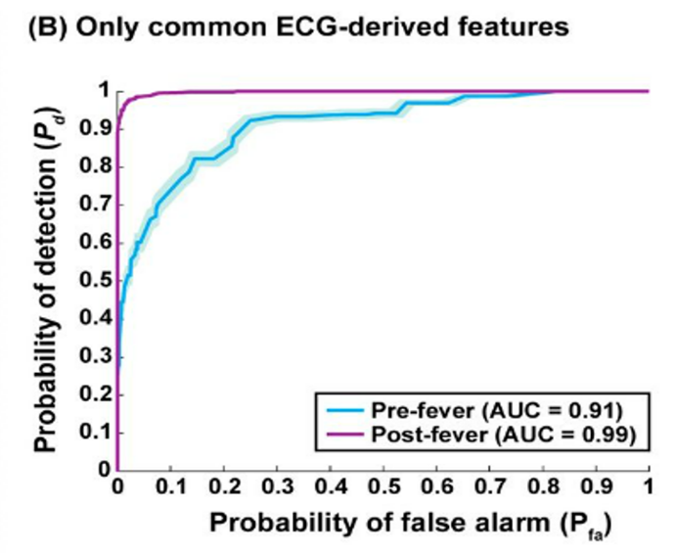
Introduction
Motivation
Increasing prevalence of wearables
Ideal contact tracing system
Pre-symptomatic exposure detection
Primate study
Invasive physiology recordings
Random forest model
Feature limitation as proof of concept
PRESAGED
Random forest (RF)
Deep neural network (DNN)
Human data from wearables
Deep neural networks for pre-symptomatic pathogen exposure detection
Milechin, L., Davis, S., Patel, T., Hernandez, M., Ciccarelli, G., Schwartz, S., ... & Swiston, A. (2017). Detecting pathogen exposure during the non-symptomatic incubation period using physiological data. bioRxiv, 218818.

Slide 3
Project Goal
Black box problem
Complex learning system
Internal mechanics are non-human interpretable
Introduce LIME and LIMESegment
Explore interpretability of DNN models

Slide 4
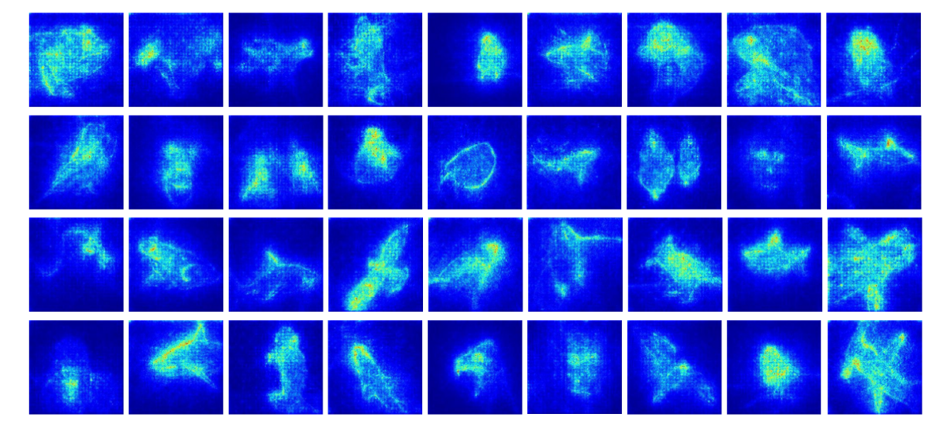
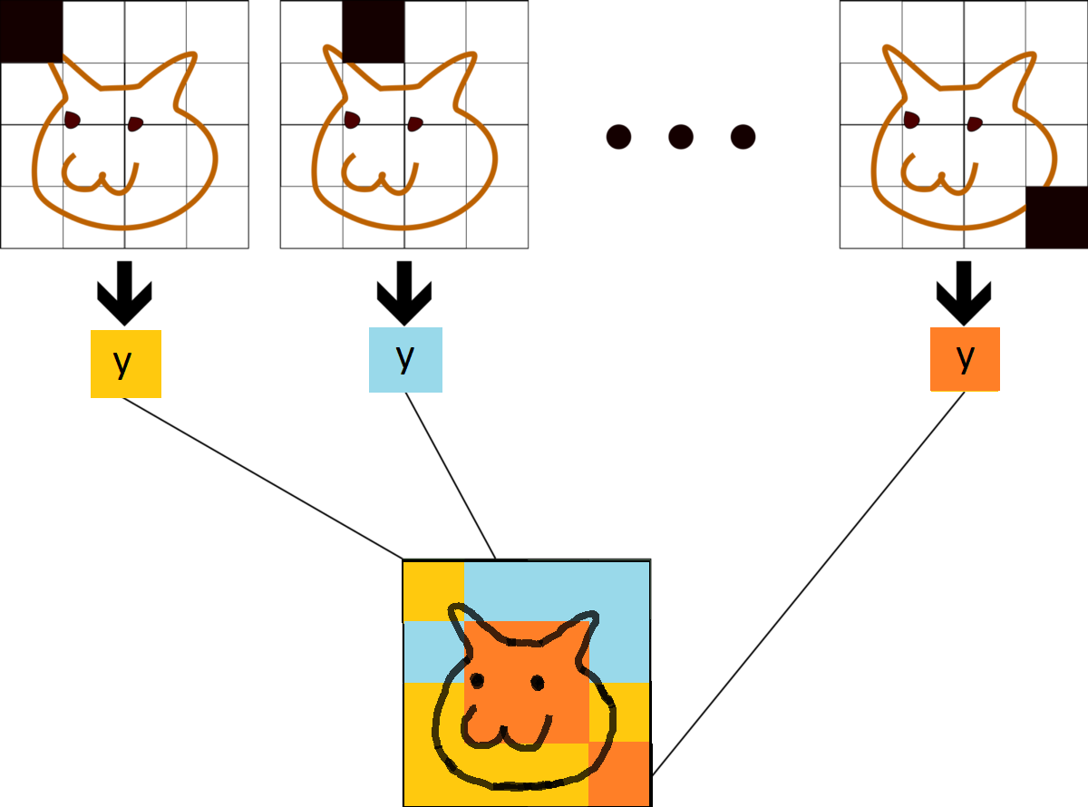
Interpretability
Comparisons to computer vision
Gradient-based methods
Utilize backpropagation
Relevance scores for input data
Perturbation methods
Feature occlusion
Feature ablation
LIME is among the most popular interpretability methods
Ismail, A. A., Gunady, M., Corrada Bravo, H., & Feizi, S. (2020). Benchmarking deep learning interpretability in time series predictions. Advances in neural information processing systems, 33, 6441-6452.

Slide 5
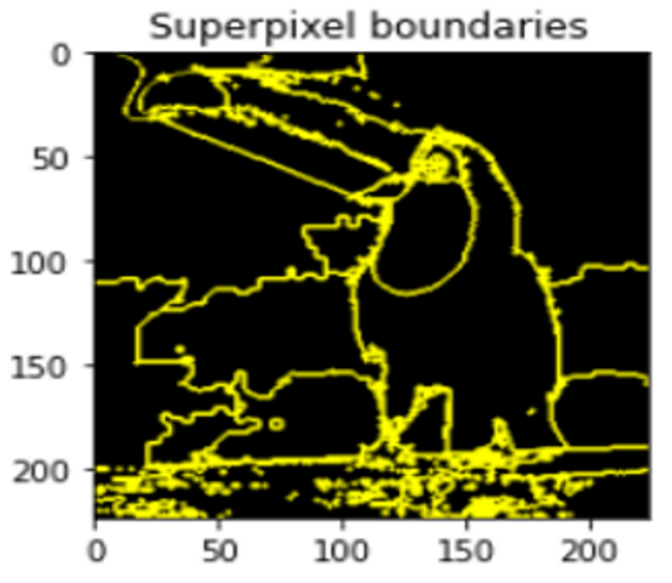
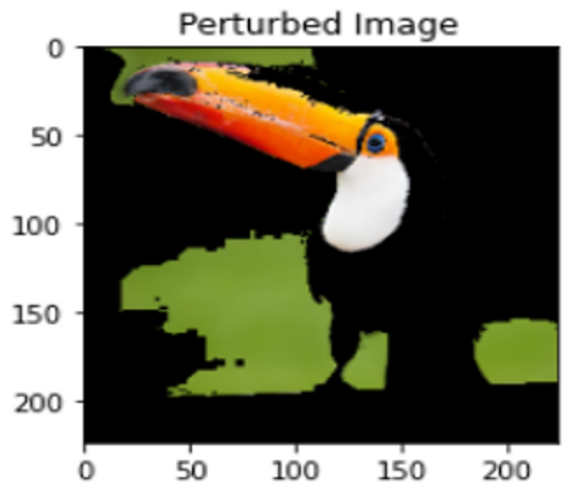
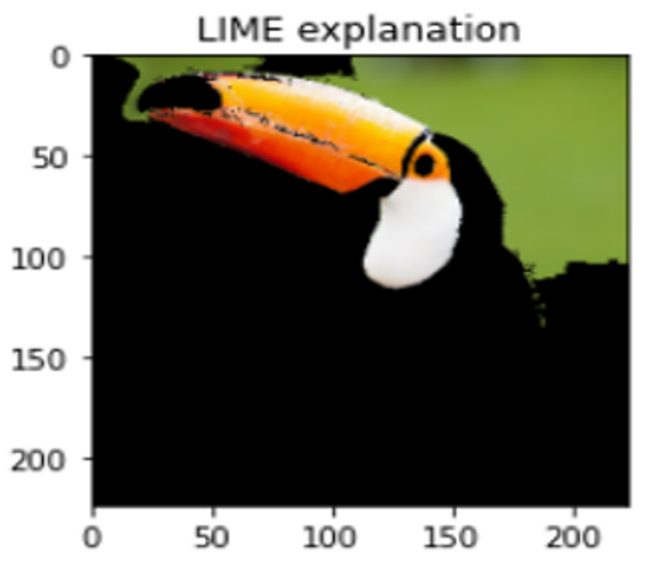
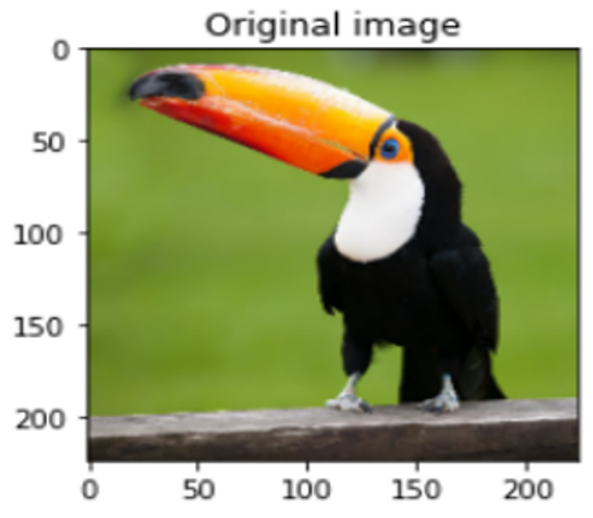
Local Interpretable Model-agnostic Explanations
First:
Split into interpretable representations
Randomly perturb representations
Generate samples
Then:
Obtain sample labels with black box model
Weight by locality & train linear model
Use coefficients as local explanation
Utilizes sampling technique + linear model to generate explanations
Ribeiro, M. T., Singh, S., & Guestrin, C. (2016, August). " Why should i trust you?" Explaining the predictions of any classifier. In Proceedings of the 22nd ACM SIGKDD international conference on knowledge discovery and data mining (pp. 1135-1144).

Slide 6
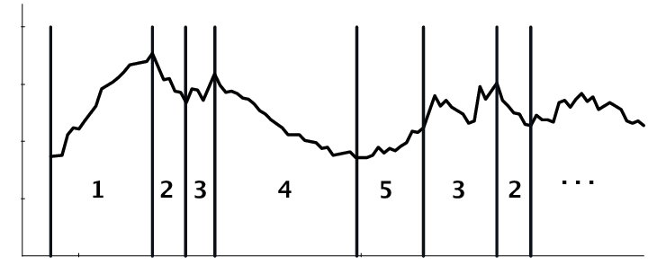
Adapting LIME to Time Series Classification
Meaningful Segmentation
Homogeneous and identifiable
Search for common segments
Realistic Background Content
Latent characteristics
Replace perturbed super segments
LIME by itself is not sufficient
A specific adaptation to time series classification is required

Slide 7
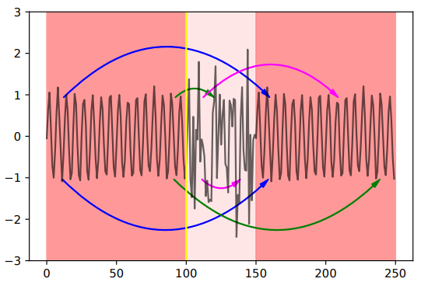
LIMESegment
change points
Nearest Neighbors Segment
Versatile time series segmentation
Identifies change points
Time series is mixture of
Similarly shaped segments
Anomalous segments
Realistic Background Perturbations
Better than noise / constant values
Frequency band with
Highest representation
Lowest variance
LIMESegment adaptation best addresses challenges
Sivill, T., & Flach, P. (2022, May). LIMESegment: Meaningful, Realistic Time Series Explanations. In International Conference on Artificial Intelligence and Statistics (pp. 3418-3433). PMLR.

Slide 8
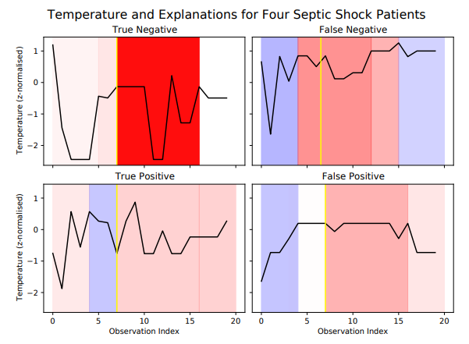
LIMESegment Continued…
Explanations for septic shock
Positive corresponds to survival
Red = LIMESegment agrees
Blue = LIMESegment disagrees
Explanations
“An individual’s temperature over the first hour in hospital was most influential to the classifier’s prediction of survival from septic shock”
Saliency
Explanations highlight both import and misleading super segments
Emergency room admittance
Sivill, T., & Flach, P. (2022, May). LIMESegment: Meaningful, Realistic Time Series Explanations. In International Conference on Artificial Intelligence and Statistics (pp. 3418-3433). PMLR.

Slide 9
Methodology
Establish model configurations to test
Adapt LIMESegment GitHub repository code
Evaluate model frameworks for interpretability with adapted LIMESegment approach

Slide 10
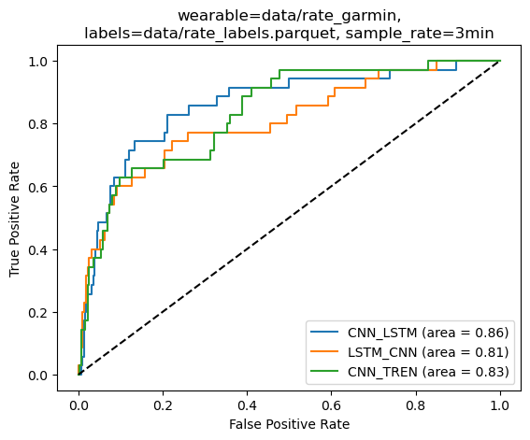
Black Box Algorithms
CNN_LSTM
Convolution + long short-term memory
Original model
LSTM_CNN
Long short-term memory + convolution
Support exists for time series applications
CNN_TREN
Convolution + transformer encoder
Attention mechanism
Model frameworks selected for interpretability

Slide 11
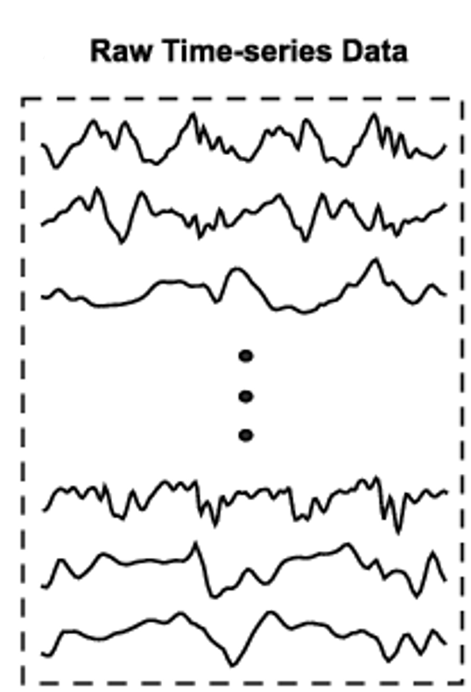
Adapting LIMESegment Code
Current implementation
Built in NumPy
Supports unimodal TS data
Adaptations
PyTorch / NumPy conversions
Support multimodal inputs
Moving to multimodal data presents challenges

Slide 12
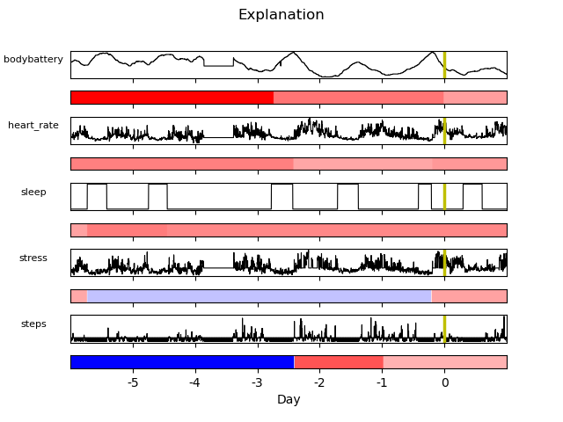
Example Explanations
CNN_LSTM
CNN_TREN
Saliency
Saliency
Indication of positive COVID test
Difficult to ascertain reasoning behind super segment importance

Slide 13
Common Problems
Ground truth labels for most important segments are not provided
Quantitative metrics for assessing interpretability frameworks are not well explored

Slide 14
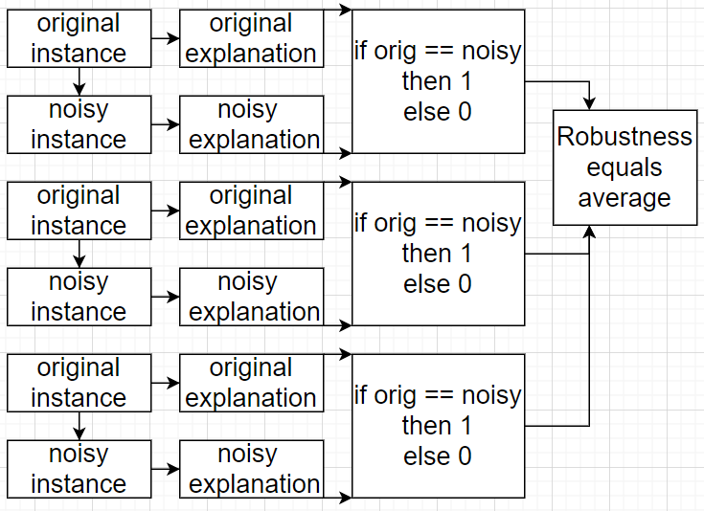
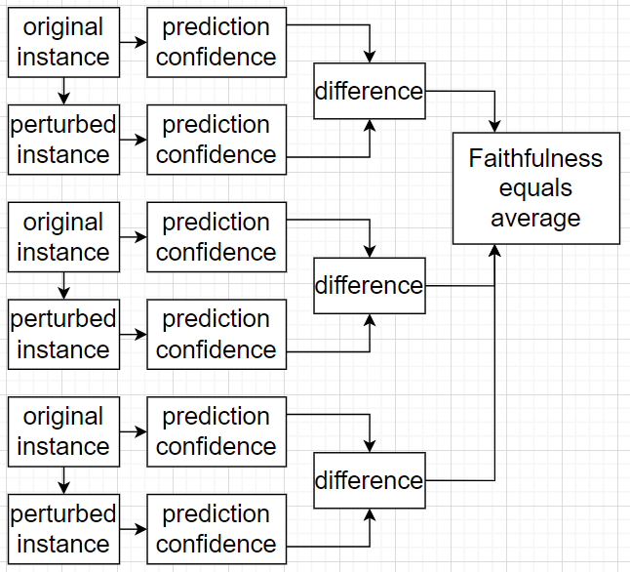
Quantitative Interpretability Metrics
Robustness
Anomalies do not influence explanation
Faithfulness
Identifies highly salient super segments
Evaluating quality of interpretability framework
Sivill, T., & Flach, P. (2022, May). LIMESegment: Meaningful, Realistic Time Series Explanations. In International Conference on Artificial Intelligence and Statistics (pp. 3418-3433). PMLR.

Slide 15
Conclusion
Standard deviation of added noise: 1e-6
 | CNN_LSTM |  | LSTM_CNN |  | CNN_TREN
Number of change points: | 1 | 2 | 1 | 2 | 1 | 2
Robustness: | 0.0% | 0.0% | 0.0% | 0.0% | 0.0% | 0.0%
Faithfulness: | 3.6% | -0.8% | -6.2% | -1.0% | 2.6% | 5.5%
Robustness metric is poor
Faithfulness metric is poor

Slide 16
Future Work
“LIMESegment explores what meaningful TS explanations could look like and leave […] methods which address longer length, multivariate TS with missing values for future work.”
In-depth hyperparameter search
Optimize Robustness and Faithfulness scores
Investigate realistic background perturbations
Other modified strategies
Common latent characteristics across test cases
Try other methods
Sivill, T., & Flach, P. (2022, May). LIMESegment: Meaningful, Realistic Time Series Explanations. In International Conference on Artificial Intelligence and Statistics (pp. 3418-3433). PMLR.

Slide 17
Questions!

